Slide 1

OPIM 5671 · Data Mining and Time Series Forecasting
Transfer Market Valuation Forecaster
Team 7
1
Notes:
We’re team 7,
Our project covers the topic of sport analytics with a transfer market evaluation forecaster.
Teams are constantly under this intense pressure to make exactly the right financial moves when they're buying and selling elite players, because millions of euros are on the line per player.
If a club submit an offer for a player, would you accept it? What's the range of value you would consider acceptable to buy or sell a player?
We've explored a data driven approach to try and answer this question by building a prototype transfer market valuation forecaster.

Slide 2
Work Division
Danilo Tambone
Dataset research & Cleaning
Visual Overview & Criteria Selection
Shijie Zhai
Model 1 & Presentation Notebook
Matthew Koh
Model 2 & Model refactoring
Robert Staniszewski III
Script & Presentation
Preshitha Sureshkumar & Heaven Buckham
Slide Deck & Presentation

Slide 3
The decision: is this player worth the price?
A club has a quoted fee. Where will the player's market value be in 6 to 12 months?
BUY
HOLD / EXTEND
SELL
Is the quoted fee below the forecast value range?
Is value expected to stay strong or rise?
Is value projected to decline?
OUR FORECASTING QUESTION
INTENDED USERS
TARGET AND HORIZON
Can historical market-value trends forecast a player's Transfermarkt value 6 to 12 months ahead?
Sporting directors
Technical / scouting directors
Player agency and negotiation teams
Transfermarkt market value (€M), quarterly
2 quarters ≈ 6 months
4 quarters ≈ 12 months
3
Notes:
Define Transfer Fee: - How much a club pays another club to purchase a player. Not the player value.
So the question we came up with was: When would you be willing to pay a transfer fee for a player?
Will that player’s value appreciate, or depreciate in the settled horizon, in our case next 6 to 12 months?
How can we tell if that player is still worth the price in the future?
A quoted fee only makes sense if you know where the player’s value will be in 6 to 12 months.
So again, is the player worth the price?
Our decision is first based on this buy, hold, or sell prototype.
Buy/Negotiate: Is the quoted fee below the forecast value range?
Hold: Is value expected to stay strong or rise?
Sell/Accept: Is value projected to decline?
Our expected users for this model would be sporting directors, scouts, agents, and betters.
The periods that we settled on for our model is 2 quarters and 4 quarters.

Slide 4
Where our data comes from
Predicting player market values for roster planning and transfer-window negotiations
Our data is a public Kaggle dataset from Transfermarkt: 508 players, 9,764 value updates, 2009 to 2026
1. What each player was worth
2. Who each player is
Like a diary of price tags: a new line each time a value was updated.
Like a player card: who they are, where they play and for which club.
What's in each row
What's in each row
Player ID
Date
Market value (€)
Player ID
Name
League
Position
Age at the time
Current club
Each row represents one valuation of one player on one date.
Each row represents one player: their name, league and club.
Target = Transfermarkt market value, not the fee a club actually pays.
Notes:
Our data is a public Kaggle dataset from Transfermarkt, with a range from 2009 to 2026.
The dataset consists of 508 players, and 9,764 value updates.
The two tables listed depict a diary of price tags per player, and a player card.
Table 1: every time a player's value was updated, a line was added.
Table 1 is what we are forecasting.
Table 2 is like a player card: name, league, club, position.
We use Table 2 to pick three players from each big league and to label our charts.
The two tables are matched by player ID. (A third file, the data dictionary, explains the columns; not used in the model.)

Slide 5

Selection criteria
We measured how complete each player's history is, then kept only players who passed four checks.
From 508 players to a 15-player modeling cohort
At least 6 years of history
508 players
At least 55% of those quarters have a real valuation, not a filled-in one
Pass the four checks
15 players
First valued by early 2019
3 best-covered players from each big-five league:
Still being valued recently
Premier League
La Liga
Serie A
Bundesliga
Ligue 1
Notes:
First, we measured how complete each player's history is: how many quarters it covers and how many of them had a real valuation.
Then we kept only players who passed four checks, and took the 3 best-covered players from each big-five league.
If asked why 15: the checks need long histories, and the league cap keeps it balanced.

Slide 6
Dates into quarters
Transfermarkt updates values at irregular times, so every player gets the same quarterly calendar.
1
Sorted into quarters
2021Q1
2021Q2
2021Q3
2021Q4
2022Q1
2022Q2
Each update lands in a quarter. Two in one quarter? We keep the latest.
€60M
€70M
–
€75M
–
€85M
2
Quiet quarters filled
2021Q1
2021Q2
2021Q3
2021Q4
2022Q1
2022Q2
The value carries forward until the next update (dashed = filled in).
€60M
€70M
€70M
€75M
€75M
€85M
Result: 455 quarterly rows, 334 real and 121 filled (through 2024Q4)
Example player is illustrative
Notes:
Transfermarkt updates a player's value whenever it decides, so the update dates are scattered.
Step 1: we sort each update into a calendar quarter; if two updates fall in one quarter we keep the latest.
Step 2: quarters with no update get the previous value carried forward, because a value stays in force until it is revised. We flag those as filled so we always know which values are real.
The series stops at 2024Q4; 2025 is held back for testing.
Result: 455 rows, 334 real, 121 filled. The example player is illustrative.

Slide 7
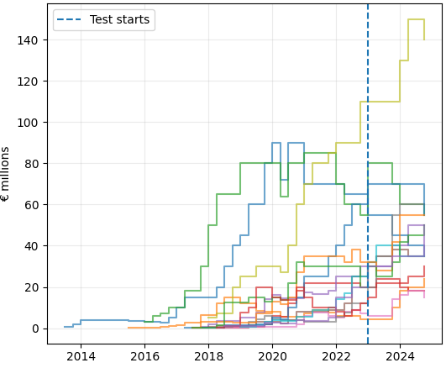
Market value path
Each line is one player.
Dashed line: where testing starts (Jan 2023).
Notes:
Alright, so.
This is the third chart of Figure 1 in our notebook.
Each line on this chart represents one of the 15 players that we selected.
This is the market value path chart we came up with based on transfermarkt's updates. each line is staircased because values stay the same until transfermarkt revises it.
The dashed vertical line is January 2023: everything to its left is history the models can learn from; everything to its right is data we hide from the models and test against.
Worth noting that some of the lines go up, some of the lines go down, and some of the lines, stay low.

Slide 8
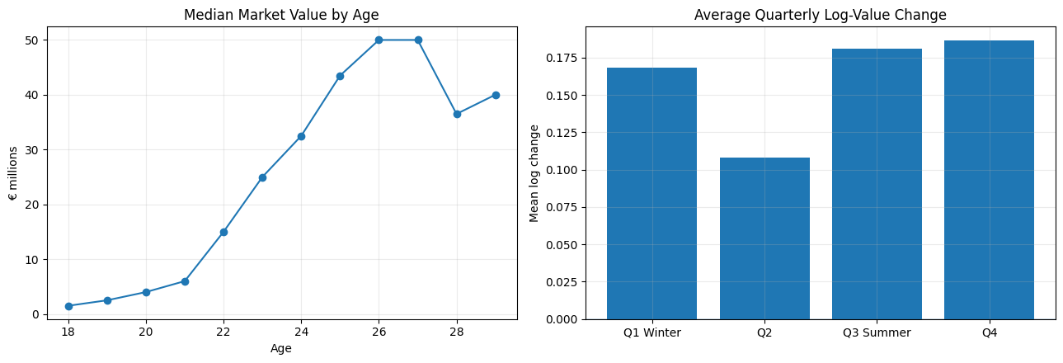
Aging curve and quarter of year
Age range: 17.3–29.3
Note: quarter effects may partly reflect Transfermarkt update timing, not transfer-price seasonality.
Notes:
These charts are from cell 10 of our notebook -
The left chart depicts median market value by age
median value rises steeply through the early 20s and peaks around 26 to 27 (about €50M), then drops
ages in the cohort run 17.3 to 29.3
The right chart depicts average quarterly change in log value by quarter
q2 is the lowest
Q4 is actually the highest bar, and q4 isn't a transfer window. the averages include filled-in quarters, so this might partly have more to do with the way transfermarkt updates player values, rather than real price seasonality. we haven't had the time or mental capacity to work through this.
we use age, alongside winter and summer flags (q1 and q3) as model inputs.

Slide 9
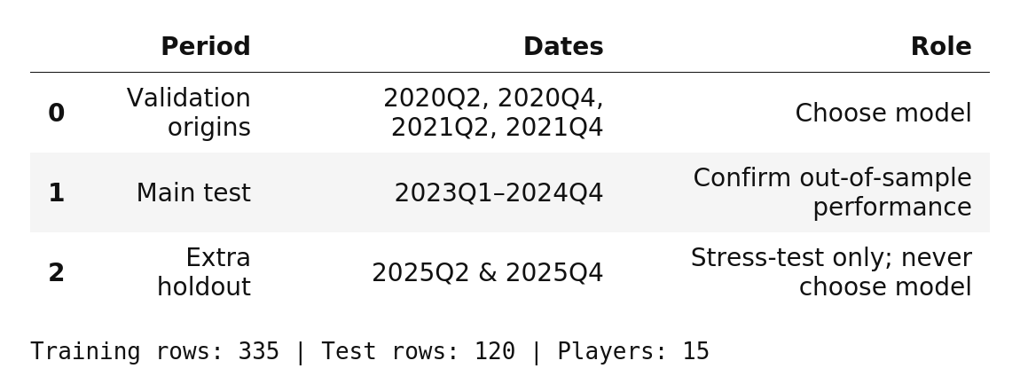
Split summary
Notes:
OKAY, this is our split summary.
Our validation chose forcasts that were made from q2 and q4 from the years 2020 and 2021.
we tested mainly on q1 of 2023 and q4 2024, (model didn't see or use these values before test, and confirmed performance.)
then we used q2 of 2025 and q4 of 2025 as a stress test.
15 players
Training rows: 335
test rows: 120

Slide 10
Candidate models: validation and test
Model | Validation |  |  | Test 2023–24
 | h=2 | h=4 | Avg | h=2 | h=4 | Avg
Damped Holt (selected) | 0.342 | 0.505 | 0.424 | 0.243 | 0.350 | 0.297
SARIMAX | 0.343 | 0.512 | 0.427 | 0.256 | 0.366 | 0.311
Persistence (benchmark) | 0.352 | 0.538 | 0.445 | 0.285 | 0.470 | 0.377
Holt + age blend | 0.350 | 0.564 | 0.457 | 0.237 | 0.351 | 0.294
Holt, trend stops at zero-growth age | 0.349 | 0.570 | 0.460 | 0.234 | 0.357 | 0.295
Holt | 0.359 | 0.581 | 0.470 | 0.243 | 0.338 | 0.290
Pooled age drift | 0.371 | 0.599 | 0.485 | 0.267 | 0.421 | 0.344
Damped Holt, log scale | 0.391 | 0.599 | 0.495 | 0.320 | 0.415 | 0.367
ARIMA per player, log scale | 0.434 | 0.600 | 0.517 | 0.309 | 0.525 | 0.417
Notes:
We compared 9 models against Persistence, the benchmark assumption that says that next value equals today's value.
all scored the same way: log MAE at 2 and 4 quarters ahead (6 and 12 months)
for our purposes, lower values are better:
log error at h-2 and h=4 which is 6 and 12 months ahead.
two rows on validation:
damped Holt 0.424
vs
persistence 0.445
Damped Holt had the lowest validation average, so we selected it.
In plain words, damped Holt follows a player's recent trend but lets it fade, so a rising player isn't projected upward forever.
Groups, if asked: trend followers (Holt, damped Holt); models using age and calendar flags (SARIMAX, pooled age drift); log-scale and per-player versions; and blends.
SARIMAX's seasonal part is switched off.
ARIMA and SARIMAX pick their settings by AIC.

Slide 11
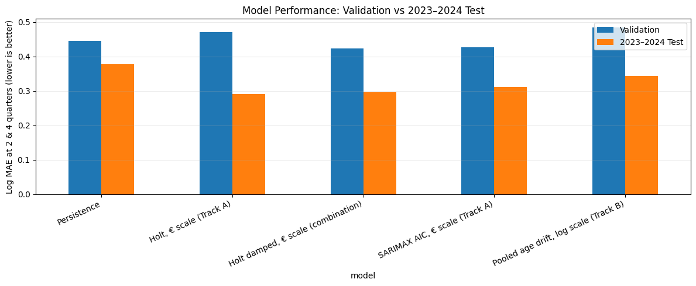
Model performance
Notes:
Blue is validation, and
Orange is 2023-24 test, for five of the nine models.
On the test, damped Holt held up: 0.297 vs 0.377 for persistence, and it beat persistence for 14 of 15 players.
Persistence is the worst on the test.
'Track A', 'Track B' and 'combination' were what we called them in our notebook.
shijie's model SARIMAX won. mine, pooled age drift, lost. I'm not mad.
but yeah I combined the two models which turned out to be something called damped holt.
plain Holt scored slightly better on the test (0.290) but worse on validation (0.470)

Slide 12
Uncertainty band and 2025 holdout
11 of 15
players lost value by 2025Q4 (median change −25%)
Model | 2025 holdout
 | h=2 | h=4 | Avg | MAE €M
Pooled age drift | 0.256 | 0.303 | 0.279 | 13.0
Holt + age blend | 0.273 | 0.295 | 0.284 | 12.7
ARIMA per player, log scale | 0.297 | 0.348 | 0.323 | 14.1
Persistence (benchmark) | 0.302 | 0.350 | 0.326 | 13.5
Holt | 0.300 | 0.353 | 0.327 | 13.8
Damped Holt (selected) | 0.308 | 0.361 | 0.335 | 14.1
Holt, trend stops at zero-growth age | 0.299 | 0.372 | 0.336 | 14.3
SARIMAX | 0.322 | 0.389 | 0.356 | 15.2
Damped Holt, log scale | 0.346 | 0.455 | 0.400 | 18.3
Uncertainty band
An 80% range around each forecast, built from the final model's validation errors.
93%
of 2023–24 test values fell inside the band
20 of 30
2025 values fell inside the band. all 10 misses were below it
13 of 30
player-horizon forecasts where the final model beat persistence
Notes:
The left side here is an 80% band around each forecast. it describes what we built from validation errors. it covered 93% of our 2023–24 test values, but only 20 of 30 in 2025. all 10 misses were below this band.
[Right side] Then 2025 happened. 11 of our 15 players lost value, a median drop of 25%. In that falling market, our chosen model, damped Holt, did slightly worse than just repeating last year's value: 0.335 versus 0.326. The best model in 2025 was the aging-curve model, at 0.279.
The band missed too. Only 20 of 30 real values landed inside it, and all 10 misses were below it, because we built it in a rising market.
So which model wins? [P3] will answer that."

Slide 13
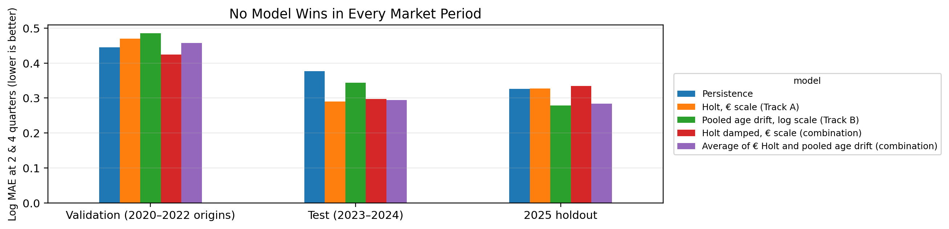
Performance across all three periods
model | Validation (2020–2022 origins) | Test (2023–2024) | 2025 holdout
Persistence | 0.445 | 0.377 | 0.326
Holt, € scale (Track A) | 0.470 | 0.290 | 0.327
Pooled age drift, log scale (Track B) | 0.485 | 0.344 | 0.279
Holt damped, € scale (combination) | 0.424 | 0.297 | 0.335
Average of € Holt and pooled age drift (combination) | 0.457 | 0.294 | 0.284
Notes:
This is the full output of PPT Figure 3 (Cell 23): the chart and the table beneath it. Same numbers as the notebook; the chart is redrawn wide so it fits with the table on one slide. Log MAE at 6 and 12 months, lower is better. The winner changes in every period: Holt damped (our selected model) on validation, plain Holt on the 2023-24 test, pooled age drift in 2025. Scores are not comparable across periods because the test was easier. Labels still carry the notebook's tags (Track A, Track B, combination); ignore them when presenting.

Slide 14
Limitations & next steps
1
2
3
4
SMALL, SELECTIVE SAMPLE
MARKET VALUE ≠ TRANSFER FEE
PERFORMANCE CHANGES WITH THE MARKET
UNCERTAINTY REMAINS HIGH
Only 15 well-covered players, chosen for long histories. Results may not hold for younger, lower-value or recently transferred players.
We forecast Transfermarkt's estimate, not the negotiated price. Contract length, injuries, club urgency and competing buyers are not captured.
Damped Holt did well in validation and 2023–24 but did not beat persistence in 2025, when 11 of 15 players lost value.
The 80% range is wide and was calibrated in a rising market. In 2025 all 10 values outside it were below the lower bound.
NEXT STEPS
Expand player pool
+
Use actual transfer fees
+
Add performance, injury, contract data
+
Recalibrate uncertainty across market regimes
14

Slide 15
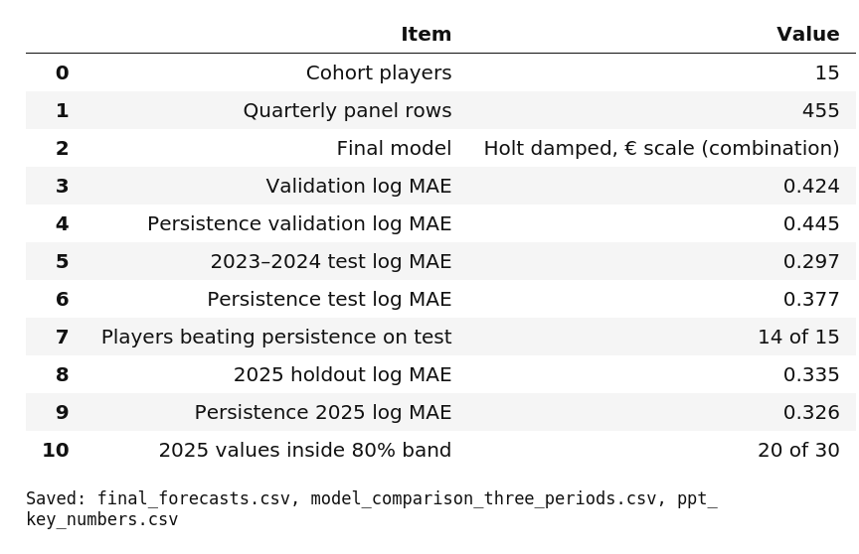
Key numbers and conclusions
Final takeaways for the presentation
The final model is selected on earlier validation origins, before the 2023–2024 test and the 2025 holdout are used.
No model is best in every period: trend-based models do well when values rise, the pooled aging curve when they fall.
A decision-support tool, not a transfer-fee oracle: market value ignores contract leverage, injuries, club urgency and negotiation.
The cohort is small and quality-selected, and the uncertainty band is shown because point forecasts alone overstate precision.
Notes:
Left: the output of Cell 29 in our notebook (PPT key numbers). Final model: damped Holt on the euro scale, chosen on validation only. Beat the no-change guess on validation (0.424 vs 0.445) and clearly on the 2023-24 test (0.297 vs 0.377, and for 14 of 15 players), but not in 2025 (0.335 vs 0.326), where 20 of 30 real values fell inside the 80% band. Right: the final takeaways, shortened from the notebook's five points (Cell 30) but kept close to its wording. The final-model label still carries the notebook's tag '(combination)'; ignore it when presenting.

Slide 16

Choose a player
Click a player to see the forecast, its 80% range and the real 2025 value.
Premier League
La Liga
Serie A
Bundesliga
Ligue 1
Phil Foden
Marcus Rashford
Loïs Openda
Serge Gnabry
Nayef Aguerd
Pedro Neto
Ronald Araujo
Teun Koopmeiners
Waldemar Anton
Kang-in Lee
Matheus Cunha
Oihan Sancet
Khéphren Thuram
Christoph Baumgartner
Jordan Teze
Notes:
INTERACTIVE SLIDE. Use Slide Show mode. Click a player to see their forecast, 80% range and the real 2025 value; click 'All players' to return here. The 15 player slides are hidden, so normal clicking skips them and goes to the next slide. Players are grouped by their current league and ordered by value at the end of 2024.

Slide 17




Decision support prototype
Player
Phil Foden
Foden
Rashford
Openda
Gnabry
Aguerd
Premier League · value at end of 2024: €140.0M
Neto
Araujo
Koopmeiners
Anton
Lee
Forecast in 12 months (2025Q4)
€158.5M
Cunha
Sancet
Thuram
Baumgartner
Teze
80% range: €97.0M to €460.1M
Horizon
Fee €475.4M
6 months
12 months
low €97.0M
high €460.1M
Quoted fee
OVERVALUED
Fee €475.4M is above the range
€79.2M
€158.5M
€316.9M
€475.4M
0.5× forecast
At forecast
2× forecast
3× forecast
HOLD / EXTEND · forecast is above the €140.0M of 2024Q4
Notes:
INTERACTIVE SLIDE (Slide Show mode). Control panel: pick a player, a horizon (6 or 12 months) and a quoted fee, and the forecast, 80% range, fee verdict and sell/hold signal update. The fee buttons are multiples of the forecast (0.5x, 1x, 2x, 3x), so the verdict changes as you move across them. Rule: fee above the 80% range = OVERVALUED, inside = FAIR RANGE, below = UNDERVALUED; forecast below the 2024Q4 value = SELL WINDOW, otherwise HOLD / EXTEND. The range is the same percentage for every player, so even 2x the forecast can read 'fair'. Click Done to come back to this slide, then continue. Behind this slide are 120 hidden slides, one per combination (15 players x 2 horizons x 4 fees).

Slide 18

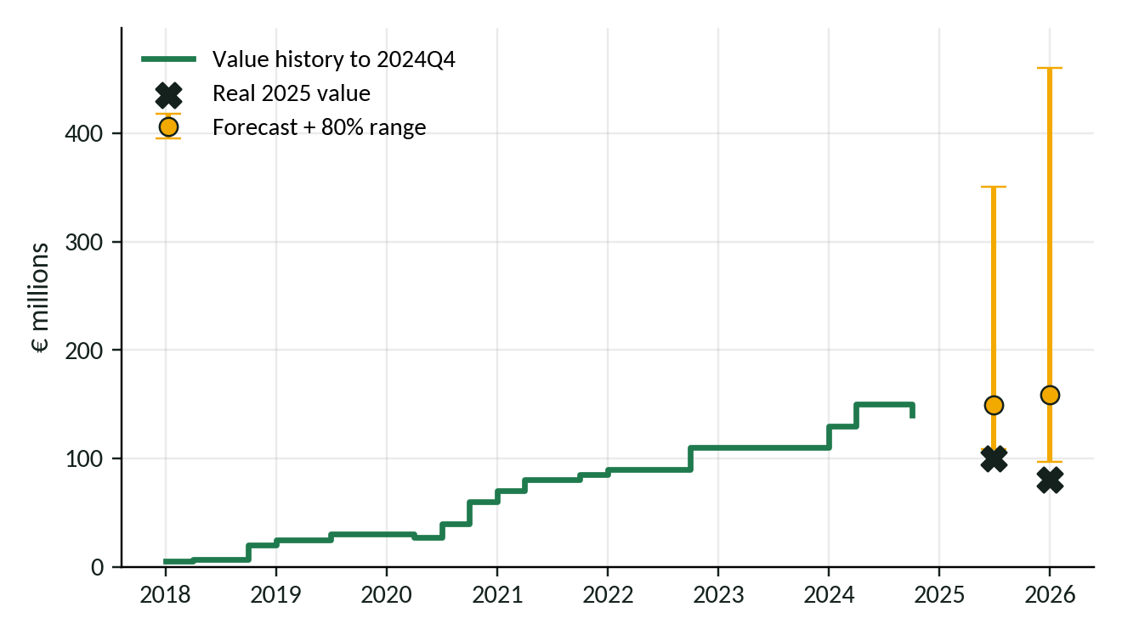


Phil Foden
← All players
Premier League · Value at the end of 2024: €140.0M
6 months ahead · 2025Q2
€149.3M forecast
80% range: €108.8M to €350.2M
Real value: €100.0M below the range
12 months ahead · 2025Q4
€158.5M forecast
80% range: €97.0M to €460.1M
Real value: €80.0M below the range
Notes:
Phil Foden: value at the end of 2024 was €140.0M. Forecast (damped Holt) and 80% range at 6 and 12 months, with the real 2025 value. 2025Q2: forecast €149.3M, range €108.8M to €350.2M, real €100.0M (below the range). 2025Q4: forecast €158.5M, range €97.0M to €460.1M, real €80.0M (below the range).

Slide 19
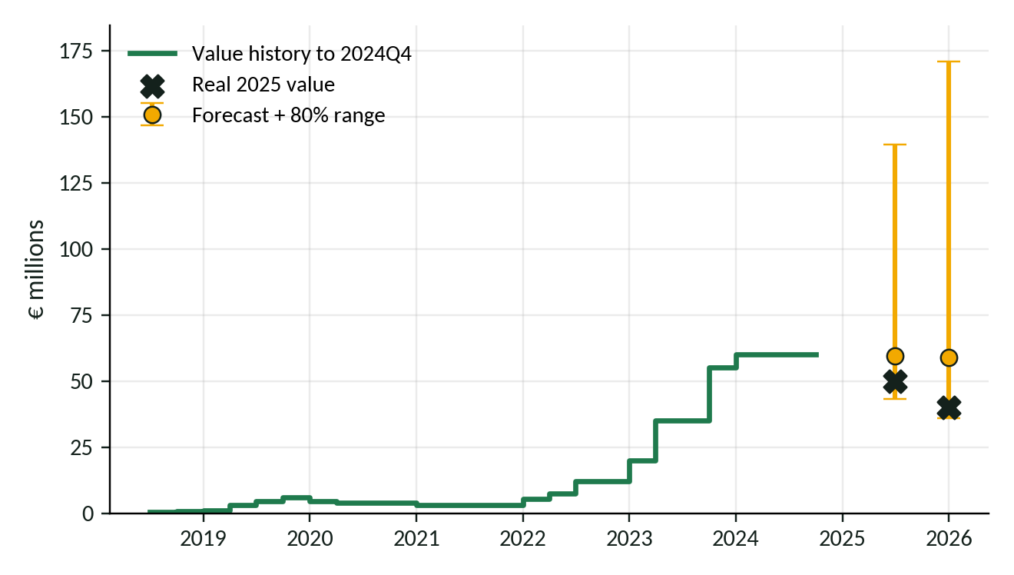
Loïs Openda
← All players
Serie A · Value at the end of 2024: €60.0M
6 months ahead · 2025Q2
€59.5M forecast
80% range: €43.3M to €139.5M
Real value: €50.0M inside the range
12 months ahead · 2025Q4
€58.8M forecast
80% range: €36.0M to €170.8M
Real value: €40.0M inside the range
Notes:
Loïs Openda: value at the end of 2024 was €60.0M. Forecast (damped Holt) and 80% range at 6 and 12 months, with the real 2025 value. 2025Q2: forecast €59.5M, range €43.3M to €139.5M, real €50.0M (inside the range). 2025Q4: forecast €58.8M, range €36.0M to €170.8M, real €40.0M (inside the range).

Slide 20
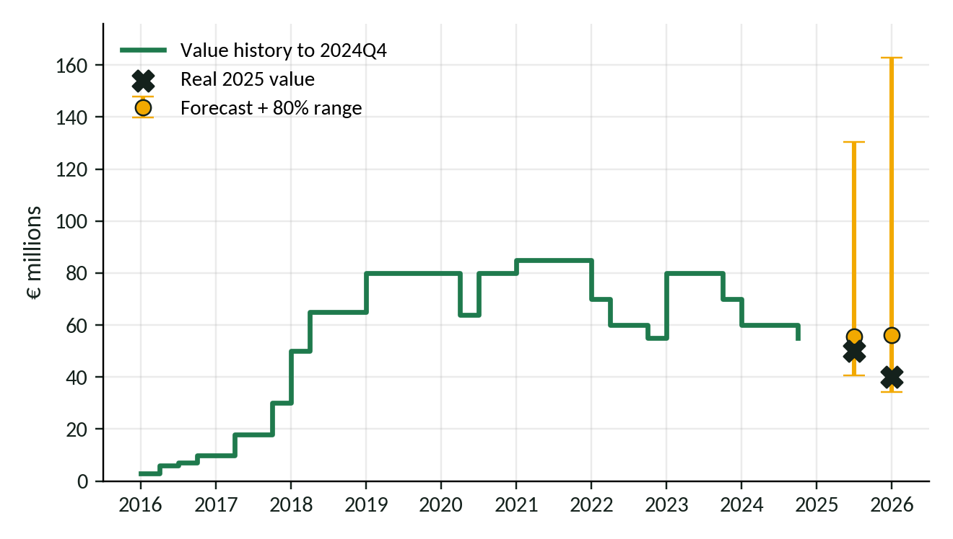
Marcus Rashford
← All players
La Liga · Value at the end of 2024: €55.0M
6 months ahead · 2025Q2
€55.6M forecast
80% range: €40.5M to €130.4M
Real value: €50.0M inside the range
12 months ahead · 2025Q4
€56.1M forecast
80% range: €34.3M to €162.9M
Real value: €40.0M inside the range
Notes:
Marcus Rashford: value at the end of 2024 was €55.0M. Forecast (damped Holt) and 80% range at 6 and 12 months, with the real 2025 value. 2025Q2: forecast €55.6M, range €40.5M to €130.4M, real €50.0M (inside the range). 2025Q4: forecast €56.1M, range €34.3M to €162.9M, real €40.0M (inside the range).

Slide 21
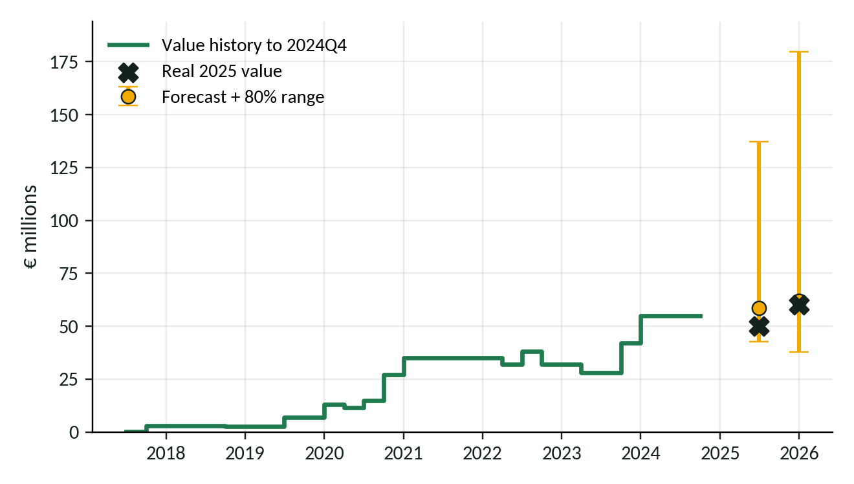
Pedro Neto
← All players
Premier League · Value at the end of 2024: €55.0M
6 months ahead · 2025Q2
€58.5M forecast
80% range: €42.6M to €137.1M
Real value: €50.0M inside the range
12 months ahead · 2025Q4
€61.9M forecast
80% range: €37.9M to €179.7M
Real value: €60.0M inside the range
Notes:
Pedro Neto: value at the end of 2024 was €55.0M. Forecast (damped Holt) and 80% range at 6 and 12 months, with the real 2025 value. 2025Q2: forecast €58.5M, range €42.6M to €137.1M, real €50.0M (inside the range). 2025Q4: forecast €61.9M, range €37.9M to €179.7M, real €60.0M (inside the range).

Slide 22
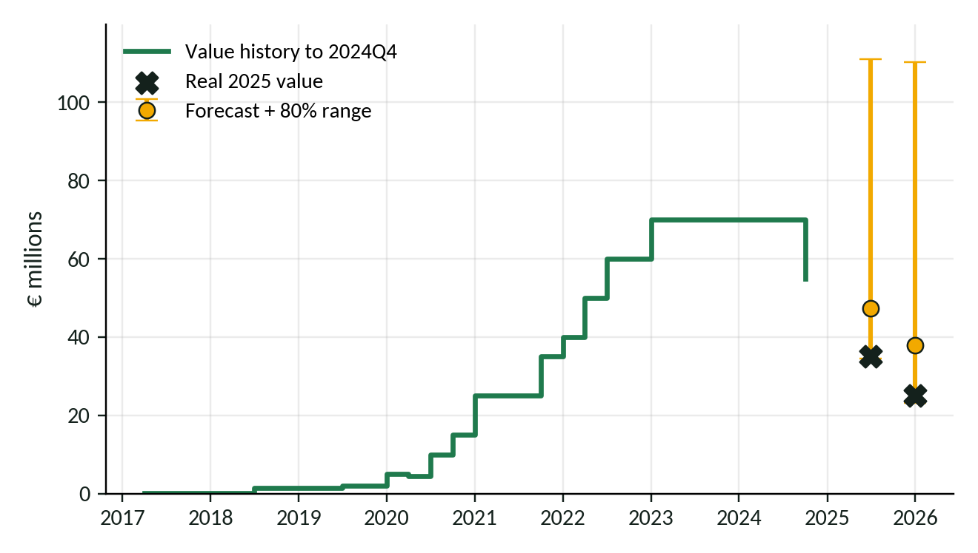
Ronald Araujo
← All players
La Liga · Value at the end of 2024: €55.0M
6 months ahead · 2025Q2
€47.3M forecast
80% range: €34.5M to €111.1M
Real value: €35.0M inside the range
12 months ahead · 2025Q4
€38.0M forecast
80% range: €23.2M to €110.3M
Real value: €25.0M inside the range
Notes:
Ronald Araujo: value at the end of 2024 was €55.0M. Forecast (damped Holt) and 80% range at 6 and 12 months, with the real 2025 value. 2025Q2: forecast €47.3M, range €34.5M to €111.1M, real €35.0M (inside the range). 2025Q4: forecast €38.0M, range €23.2M to €110.3M, real €25.0M (inside the range).

Slide 23
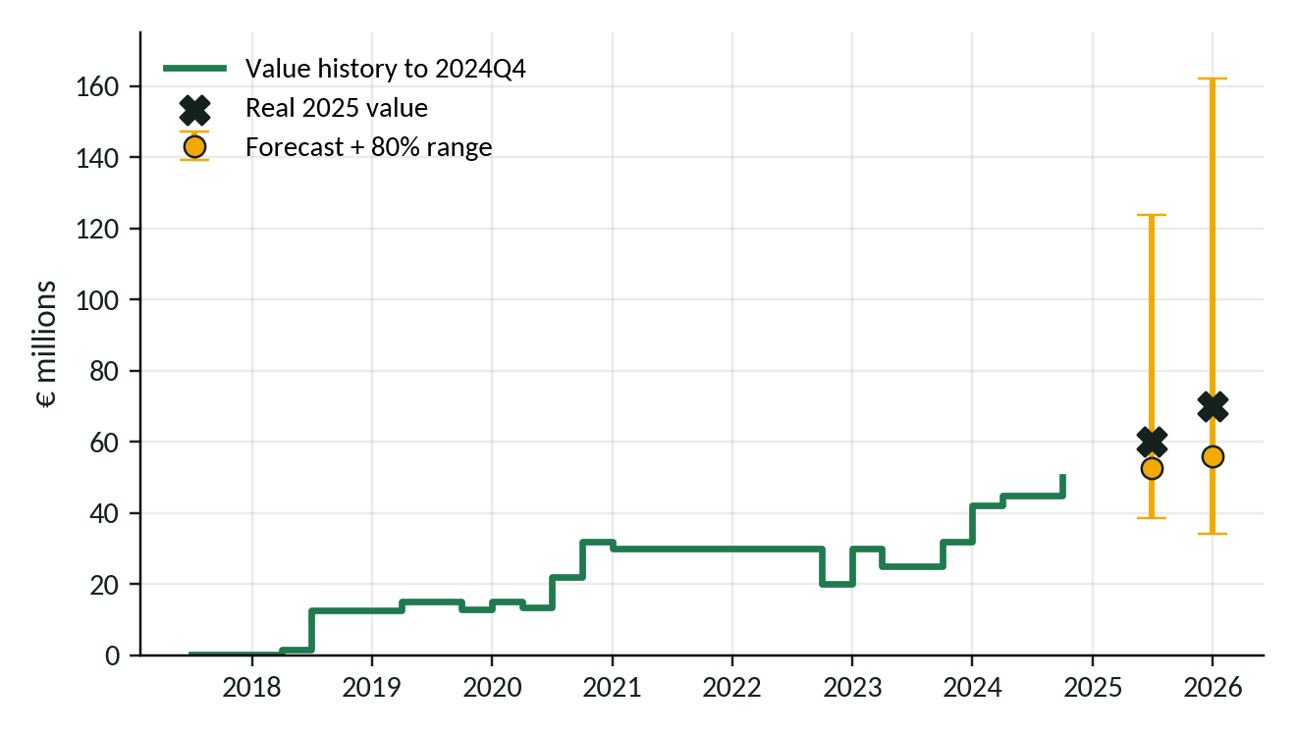
Matheus Cunha
← All players
Premier League · Value at the end of 2024: €50.0M
6 months ahead · 2025Q2
€52.7M forecast
80% range: €38.4M to €123.7M
Real value: €60.0M inside the range
12 months ahead · 2025Q4
€55.8M forecast
80% range: €34.2M to €162.2M
Real value: €70.0M inside the range
Notes:
Matheus Cunha: value at the end of 2024 was €50.0M. Forecast (damped Holt) and 80% range at 6 and 12 months, with the real 2025 value. 2025Q2: forecast €52.7M, range €38.4M to €123.7M, real €60.0M (inside the range). 2025Q4: forecast €55.8M, range €34.2M to €162.2M, real €70.0M (inside the range).

Slide 24
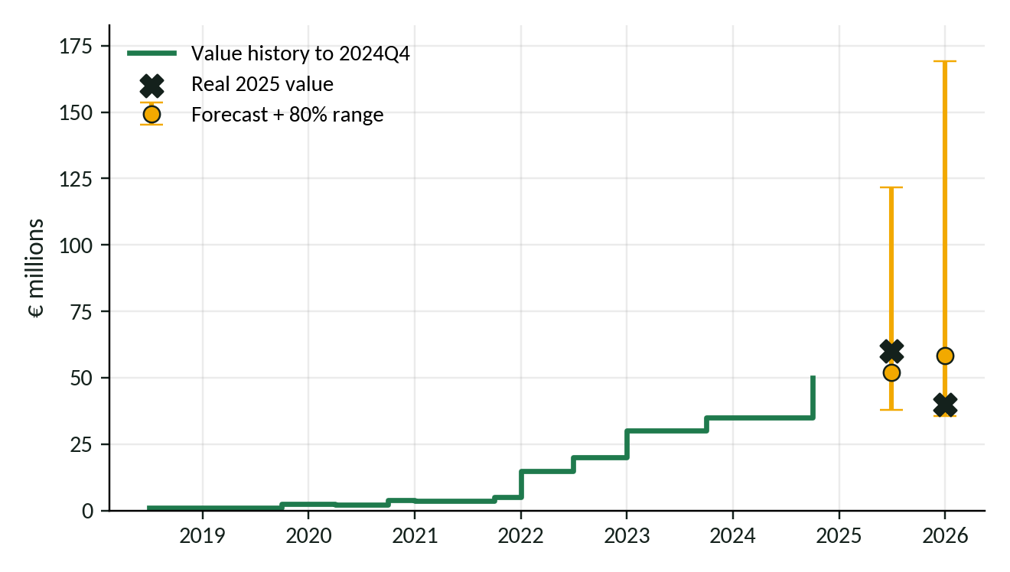
Oihan Sancet
← All players
La Liga · Value at the end of 2024: €50.0M
6 months ahead · 2025Q2
€51.9M forecast
80% range: €37.8M to €121.8M
Real value: €60.0M inside the range
12 months ahead · 2025Q4
€58.3M forecast
80% range: €35.7M to €169.2M
Real value: €40.0M inside the range
Notes:
Oihan Sancet: value at the end of 2024 was €50.0M. Forecast (damped Holt) and 80% range at 6 and 12 months, with the real 2025 value. 2025Q2: forecast €51.9M, range €37.8M to €121.8M, real €60.0M (inside the range). 2025Q4: forecast €58.3M, range €35.7M to €169.2M, real €40.0M (inside the range).

Slide 25
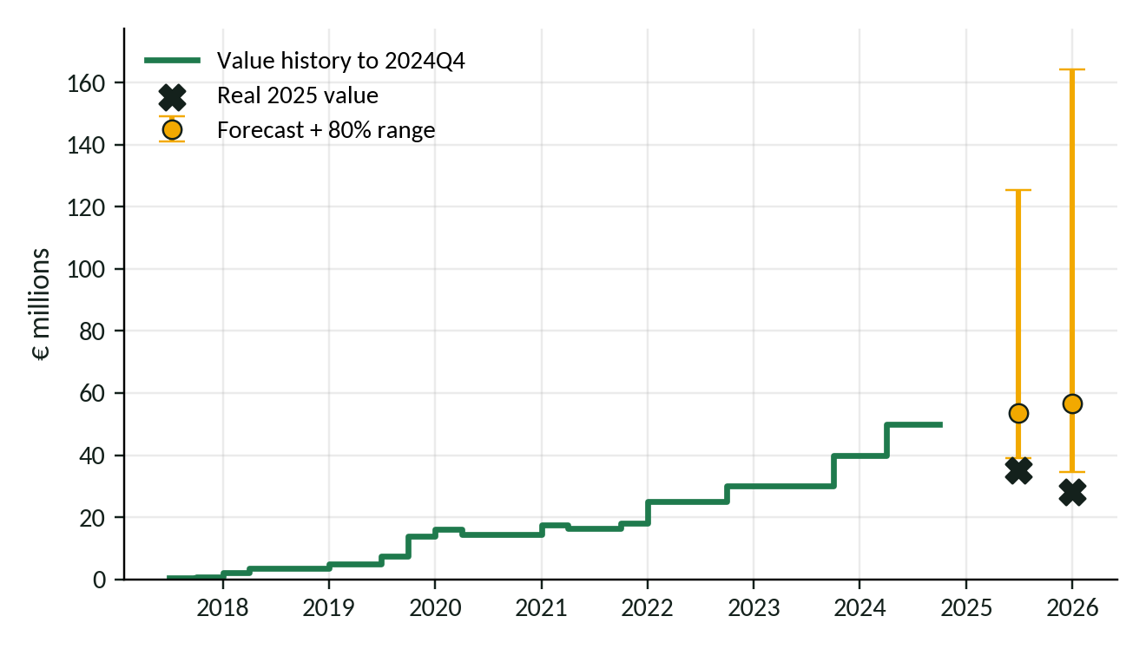
Teun Koopmeiners
← All players
Serie A · Value at the end of 2024: €50.0M
6 months ahead · 2025Q2
€53.5M forecast
80% range: €39.0M to €125.4M
Real value: €35.0M below the range
12 months ahead · 2025Q4
€56.6M forecast
80% range: €34.6M to €164.3M
Real value: €28.0M below the range
Notes:
Teun Koopmeiners: value at the end of 2024 was €50.0M. Forecast (damped Holt) and 80% range at 6 and 12 months, with the real 2025 value. 2025Q2: forecast €53.5M, range €39.0M to €125.4M, real €35.0M (below the range). 2025Q4: forecast €56.6M, range €34.6M to €164.3M, real €28.0M (below the range).

Slide 26
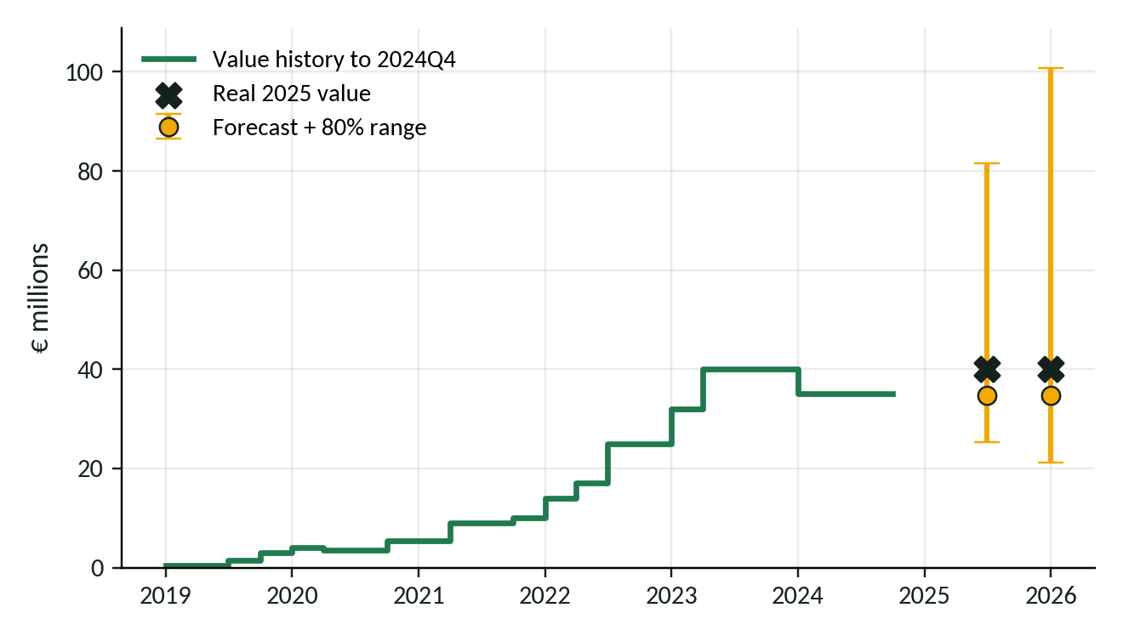
Khéphren Thuram
← All players
Serie A · Value at the end of 2024: €35.0M
6 months ahead · 2025Q2
€34.8M forecast
80% range: €25.4M to €81.6M
Real value: €40.0M inside the range
12 months ahead · 2025Q4
€34.7M forecast
80% range: €21.2M to €100.8M
Real value: €40.0M inside the range
Notes:
Khéphren Thuram: value at the end of 2024 was €35.0M. Forecast (damped Holt) and 80% range at 6 and 12 months, with the real 2025 value. 2025Q2: forecast €34.8M, range €25.4M to €81.6M, real €40.0M (inside the range). 2025Q4: forecast €34.7M, range €21.2M to €100.8M, real €40.0M (inside the range).

Slide 27
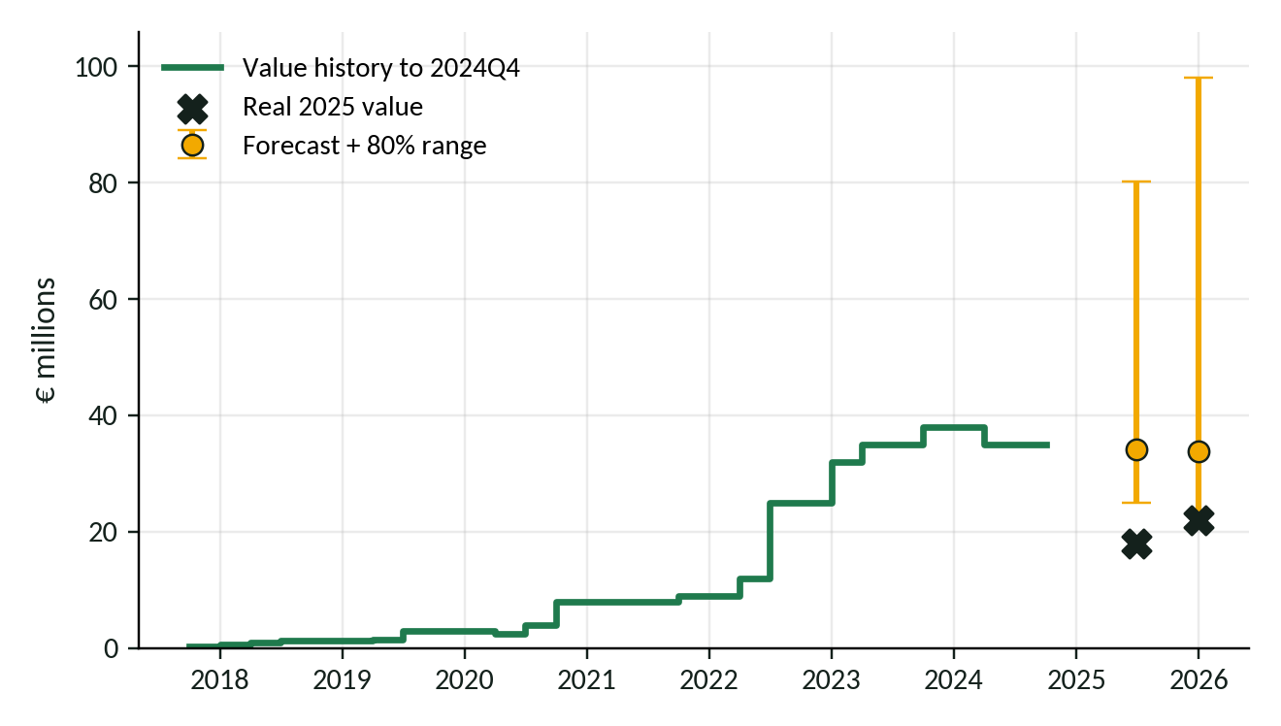
Nayef Aguerd
← All players
Ligue 1 · Value at the end of 2024: €35.0M
6 months ahead · 2025Q2
€34.2M forecast
80% range: €24.9M to €80.1M
Real value: €18.0M below the range
12 months ahead · 2025Q4
€33.8M forecast
80% range: €20.7M to €98.1M
Real value: €22.0M inside the range
Notes:
Nayef Aguerd: value at the end of 2024 was €35.0M. Forecast (damped Holt) and 80% range at 6 and 12 months, with the real 2025 value. 2025Q2: forecast €34.2M, range €24.9M to €80.1M, real €18.0M (below the range). 2025Q4: forecast €33.8M, range €20.7M to €98.1M, real €22.0M (inside the range).

Slide 28
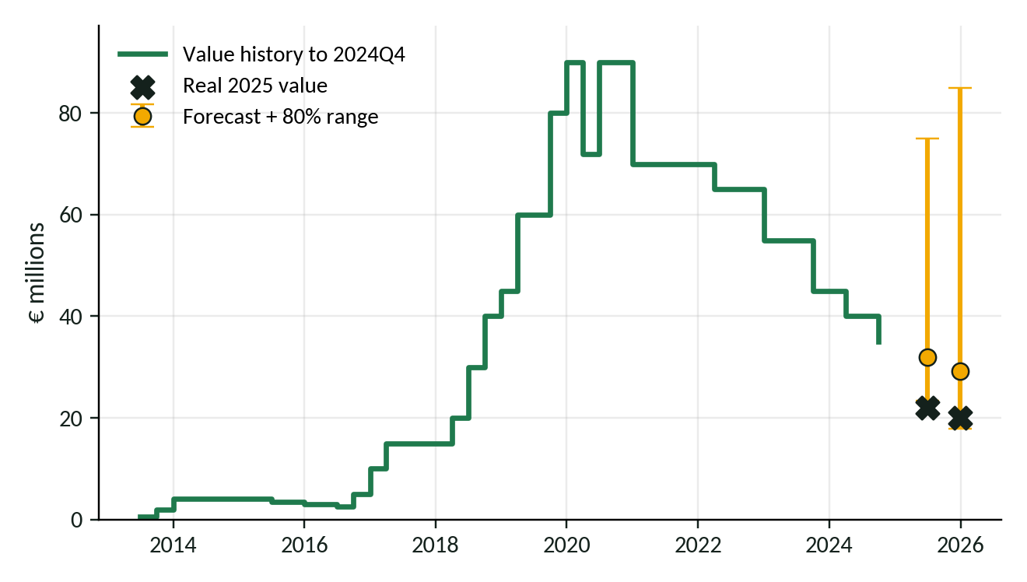
Serge Gnabry
← All players
Bundesliga · Value at the end of 2024: €35.0M
6 months ahead · 2025Q2
€32.0M forecast
80% range: €23.3M to €75.1M
Real value: €22.0M below the range
12 months ahead · 2025Q4
€29.2M forecast
80% range: €17.9M to €84.9M
Real value: €20.0M inside the range
Notes:
Serge Gnabry: value at the end of 2024 was €35.0M. Forecast (damped Holt) and 80% range at 6 and 12 months, with the real 2025 value. 2025Q2: forecast €32.0M, range €23.3M to €75.1M, real €22.0M (below the range). 2025Q4: forecast €29.2M, range €17.9M to €84.9M, real €20.0M (inside the range).

Slide 29
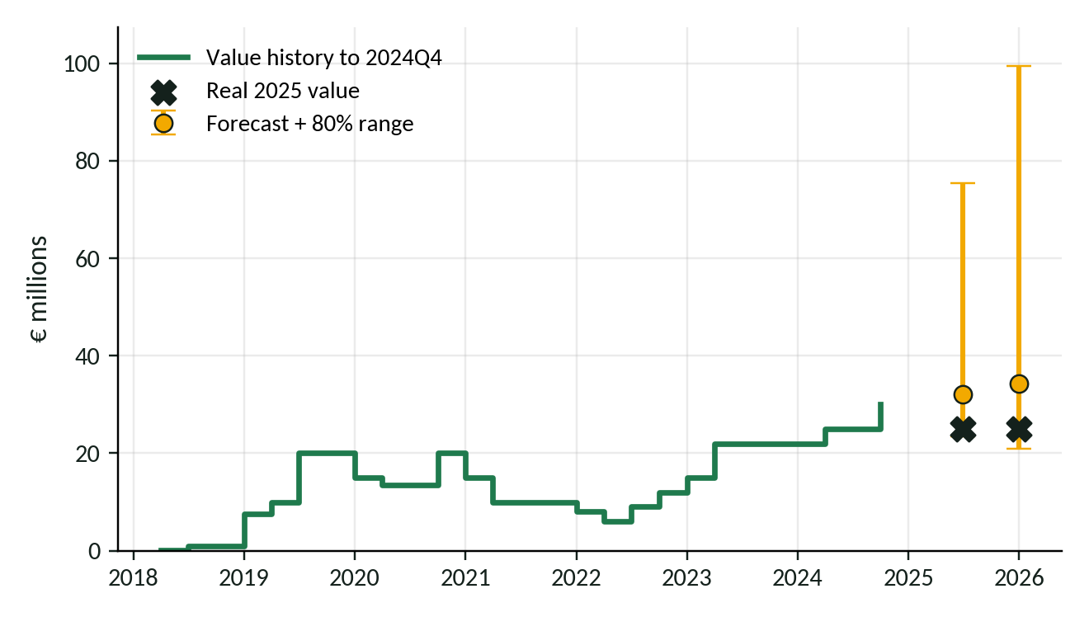
Kang-in Lee
← All players
Ligue 1 · Value at the end of 2024: €30.0M
6 months ahead · 2025Q2
€32.1M forecast
80% range: €23.4M to €75.4M
Real value: €25.0M inside the range
12 months ahead · 2025Q4
€34.2M forecast
80% range: €21.0M to €99.5M
Real value: €25.0M inside the range
Notes:
Kang-in Lee: value at the end of 2024 was €30.0M. Forecast (damped Holt) and 80% range at 6 and 12 months, with the real 2025 value. 2025Q2: forecast €32.1M, range €23.4M to €75.4M, real €25.0M (inside the range). 2025Q4: forecast €34.2M, range €21.0M to €99.5M, real €25.0M (inside the range).

Slide 30
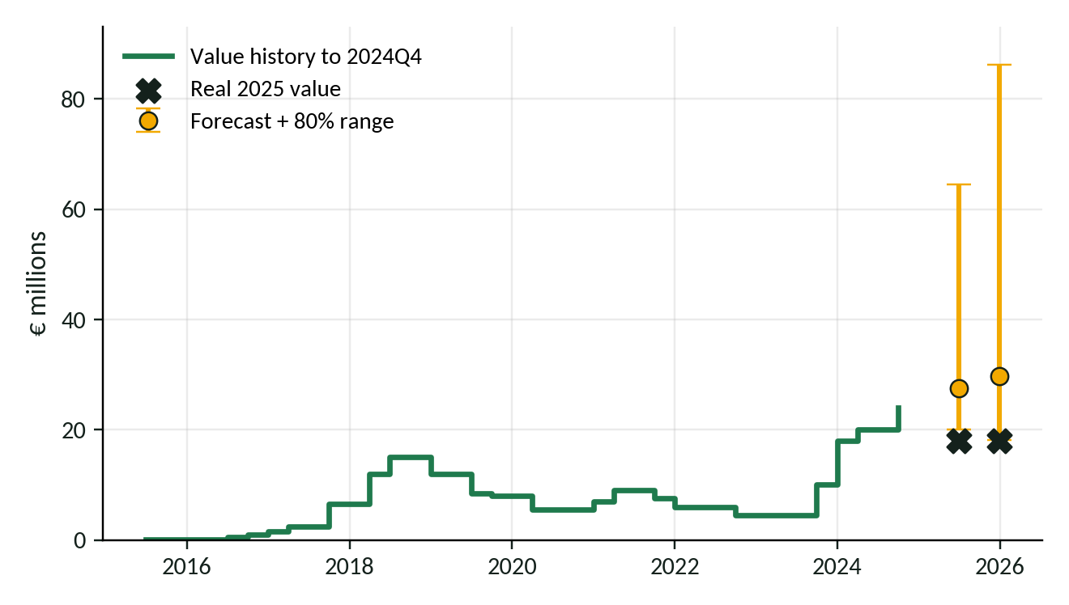
Waldemar Anton
← All players
Bundesliga · Value at the end of 2024: €24.0M
6 months ahead · 2025Q2
€27.5M forecast
80% range: €20.0M to €64.5M
Real value: €18.0M below the range
12 months ahead · 2025Q4
€29.7M forecast
80% range: €18.2M to €86.2M
Real value: €18.0M below the range
Notes:
Waldemar Anton: value at the end of 2024 was €24.0M. Forecast (damped Holt) and 80% range at 6 and 12 months, with the real 2025 value. 2025Q2: forecast €27.5M, range €20.0M to €64.5M, real €18.0M (below the range). 2025Q4: forecast €29.7M, range €18.2M to €86.2M, real €18.0M (below the range).

Slide 31
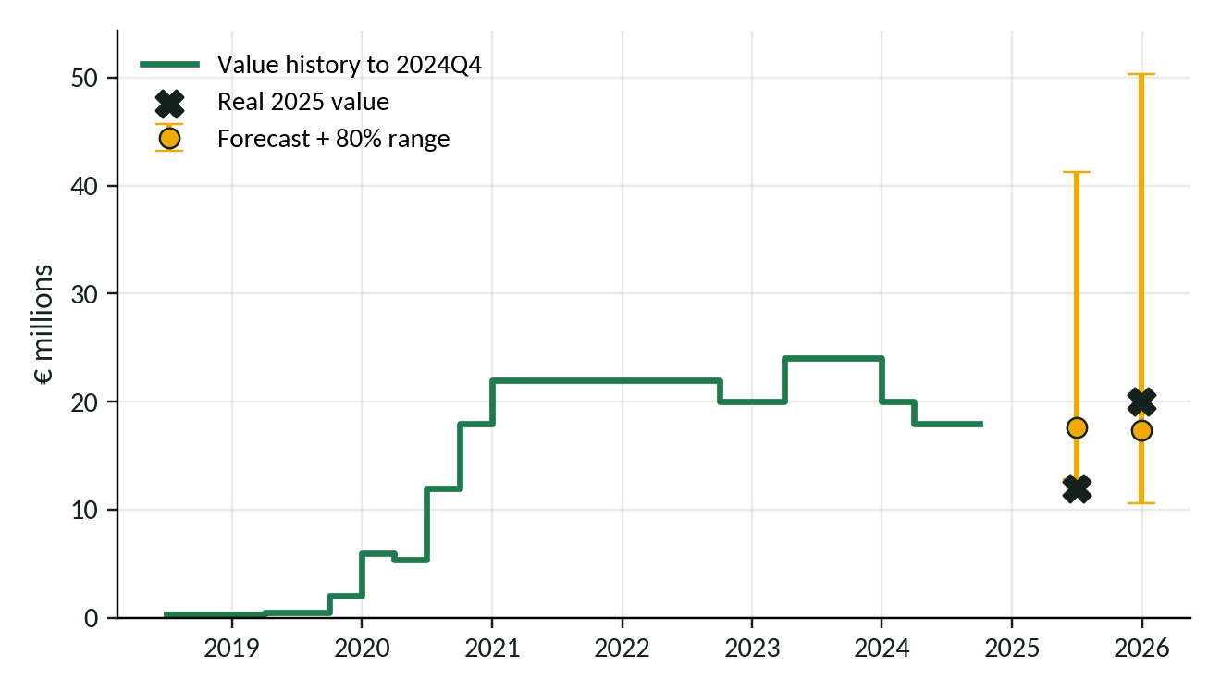
Christoph Baumgartner
← All players
Bundesliga · Value at the end of 2024: €18.0M
6 months ahead · 2025Q2
€17.6M forecast
80% range: €12.8M to €41.3M
Real value: €12.0M below the range
12 months ahead · 2025Q4
€17.3M forecast
80% range: €10.6M to €50.3M
Real value: €20.0M inside the range
Notes:
Christoph Baumgartner: value at the end of 2024 was €18.0M. Forecast (damped Holt) and 80% range at 6 and 12 months, with the real 2025 value. 2025Q2: forecast €17.6M, range €12.8M to €41.3M, real €12.0M (below the range). 2025Q4: forecast €17.3M, range €10.6M to €50.3M, real €20.0M (inside the range).

Slide 32
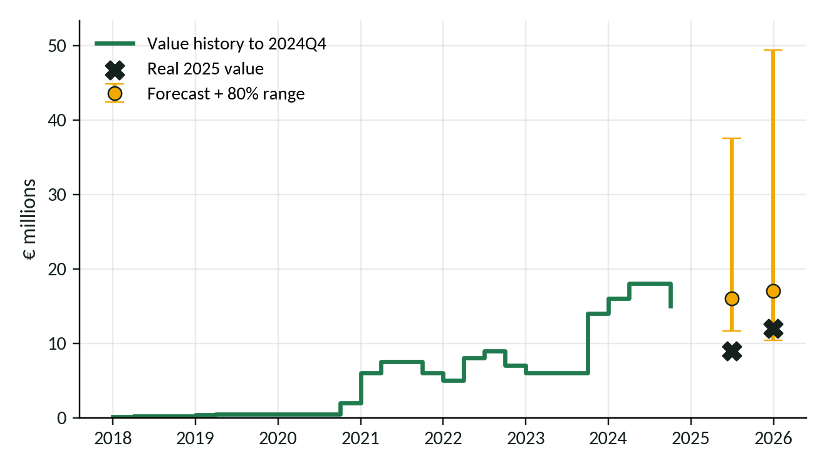
Jordan Teze
← All players
Ligue 1 · Value at the end of 2024: €15.0M
6 months ahead · 2025Q2
€16.0M forecast
80% range: €11.7M to €37.6M
Real value: €9.0M below the range
12 months ahead · 2025Q4
€17.0M forecast
80% range: €10.4M to €49.4M
Real value: €12.0M inside the range
Notes:
Jordan Teze: value at the end of 2024 was €15.0M. Forecast (damped Holt) and 80% range at 6 and 12 months, with the real 2025 value. 2025Q2: forecast €16.0M, range €11.7M to €37.6M, real €9.0M (below the range). 2025Q4: forecast €17.0M, range €10.4M to €49.4M, real €12.0M (inside the range).

Slide 33
Decision support prototype
Done
Player
Phil Foden
Foden
Rashford
Openda
Gnabry
Aguerd
Premier League · value at end of 2024: €140.0M
Neto
Araujo
Koopmeiners
Anton
Lee
Forecast in 6 months (2025Q2)
€149.3M
Cunha
Sancet
Thuram
Baumgartner
Teze
80% range: €108.8M to €350.2M
Horizon
Fee €74.6M
6 months
12 months
low €108.8M
high €350.2M
Quoted fee
UNDERVALUED
Fee €74.6M is below the range
€74.6M
€149.3M
€298.5M
€447.8M
0.5× forecast
At forecast
2× forecast
3× forecast
HOLD / EXTEND · forecast is above the €140.0M of 2024Q4

Slide 34

Decision support prototype
Done
Player
Phil Foden
Foden
Rashford
Openda
Gnabry
Aguerd
Premier League · value at end of 2024: €140.0M
Neto
Araujo
Koopmeiners
Anton
Lee
Forecast in 6 months (2025Q2)
€149.3M
Cunha
Sancet
Thuram
Baumgartner
Teze
80% range: €108.8M to €350.2M
Horizon
Fee €149.3M
6 months
12 months
low €108.8M
high €350.2M
Quoted fee
FAIR RANGE
Fee €149.3M is inside the range
€74.6M
€149.3M
€298.5M
€447.8M
0.5× forecast
At forecast
2× forecast
3× forecast
HOLD / EXTEND · forecast is above the €140.0M of 2024Q4

Slide 35
Decision support prototype
Done
Player
Phil Foden
Foden
Rashford
Openda
Gnabry
Aguerd
Premier League · value at end of 2024: €140.0M
Neto
Araujo
Koopmeiners
Anton
Lee
Forecast in 6 months (2025Q2)
€149.3M
Cunha
Sancet
Thuram
Baumgartner
Teze
80% range: €108.8M to €350.2M
Horizon
Fee €298.5M
6 months
12 months
low €108.8M
high €350.2M
Quoted fee
FAIR RANGE
Fee €298.5M is inside the range
€74.6M
€149.3M
€298.5M
€447.8M
0.5× forecast
At forecast
2× forecast
3× forecast
HOLD / EXTEND · forecast is above the €140.0M of 2024Q4

Slide 36
Decision support prototype
Done
Player
Phil Foden
Foden
Rashford
Openda
Gnabry
Aguerd
Premier League · value at end of 2024: €140.0M
Neto
Araujo
Koopmeiners
Anton
Lee
Forecast in 6 months (2025Q2)
€149.3M
Cunha
Sancet
Thuram
Baumgartner
Teze
80% range: €108.8M to €350.2M
Horizon
Fee €447.8M
6 months
12 months
low €108.8M
high €350.2M
Quoted fee
OVERVALUED
Fee €447.8M is above the range
€74.6M
€149.3M
€298.5M
€447.8M
0.5× forecast
At forecast
2× forecast
3× forecast
HOLD / EXTEND · forecast is above the €140.0M of 2024Q4

Slide 37
Decision support prototype
Done
Player
Phil Foden
Foden
Rashford
Openda
Gnabry
Aguerd
Premier League · value at end of 2024: €140.0M
Neto
Araujo
Koopmeiners
Anton
Lee
Forecast in 12 months (2025Q4)
€158.5M
Cunha
Sancet
Thuram
Baumgartner
Teze
80% range: €97.0M to €460.1M
Horizon
Fee €79.2M
6 months
12 months
low €97.0M
high €460.1M
Quoted fee
UNDERVALUED
Fee €79.2M is below the range
€79.2M
€158.5M
€316.9M
€475.4M
0.5× forecast
At forecast
2× forecast
3× forecast
HOLD / EXTEND · forecast is above the €140.0M of 2024Q4

Slide 38
Decision support prototype
Done
Player
Phil Foden
Foden
Rashford
Openda
Gnabry
Aguerd
Premier League · value at end of 2024: €140.0M
Neto
Araujo
Koopmeiners
Anton
Lee
Forecast in 12 months (2025Q4)
€158.5M
Cunha
Sancet
Thuram
Baumgartner
Teze
80% range: €97.0M to €460.1M
Horizon
Fee €158.5M
6 months
12 months
low €97.0M
high €460.1M
Quoted fee
FAIR RANGE
Fee €158.5M is inside the range
€79.2M
€158.5M
€316.9M
€475.4M
0.5× forecast
At forecast
2× forecast
3× forecast
HOLD / EXTEND · forecast is above the €140.0M of 2024Q4

Slide 39
Decision support prototype
Done
Player
Phil Foden
Foden
Rashford
Openda
Gnabry
Aguerd
Premier League · value at end of 2024: €140.0M
Neto
Araujo
Koopmeiners
Anton
Lee
Forecast in 12 months (2025Q4)
€158.5M
Cunha
Sancet
Thuram
Baumgartner
Teze
80% range: €97.0M to €460.1M
Horizon
Fee €316.9M
6 months
12 months
low €97.0M
high €460.1M
Quoted fee
FAIR RANGE
Fee €316.9M is inside the range
€79.2M
€158.5M
€316.9M
€475.4M
0.5× forecast
At forecast
2× forecast
3× forecast
HOLD / EXTEND · forecast is above the €140.0M of 2024Q4

Slide 40
Decision support prototype
Done
Player
Phil Foden
Foden
Rashford
Openda
Gnabry
Aguerd
Premier League · value at end of 2024: €140.0M
Neto
Araujo
Koopmeiners
Anton
Lee
Forecast in 12 months (2025Q4)
€158.5M
Cunha
Sancet
Thuram
Baumgartner
Teze
80% range: €97.0M to €460.1M
Horizon
Fee €475.4M
6 months
12 months
low €97.0M
high €460.1M
Quoted fee
OVERVALUED
Fee €475.4M is above the range
€79.2M
€158.5M
€316.9M
€475.4M
0.5× forecast
At forecast
2× forecast
3× forecast
HOLD / EXTEND · forecast is above the €140.0M of 2024Q4

Slide 41
Decision support prototype
Done
Player
Pedro Neto
Foden
Rashford
Openda
Gnabry
Aguerd
Premier League · value at end of 2024: €55.0M
Neto
Araujo
Koopmeiners
Anton
Lee
Forecast in 6 months (2025Q2)
€58.5M
Cunha
Sancet
Thuram
Baumgartner
Teze
80% range: €42.6M to €137.1M
Horizon
Fee €29.2M
6 months
12 months
low €42.6M
high €137.1M
Quoted fee
UNDERVALUED
Fee €29.2M is below the range
€29.2M
€58.5M
€116.9M
€175.4M
0.5× forecast
At forecast
2× forecast
3× forecast
HOLD / EXTEND · forecast is above the €55.0M of 2024Q4

Slide 42
Decision support prototype
Done
Player
Pedro Neto
Foden
Rashford
Openda
Gnabry
Aguerd
Premier League · value at end of 2024: €55.0M
Neto
Araujo
Koopmeiners
Anton
Lee
Forecast in 6 months (2025Q2)
€58.5M
Cunha
Sancet
Thuram
Baumgartner
Teze
80% range: €42.6M to €137.1M
Horizon
Fee €58.5M
6 months
12 months
low €42.6M
high €137.1M
Quoted fee
FAIR RANGE
Fee €58.5M is inside the range
€29.2M
€58.5M
€116.9M
€175.4M
0.5× forecast
At forecast
2× forecast
3× forecast
HOLD / EXTEND · forecast is above the €55.0M of 2024Q4

Slide 43
Decision support prototype
Done
Player
Pedro Neto
Foden
Rashford
Openda
Gnabry
Aguerd
Premier League · value at end of 2024: €55.0M
Neto
Araujo
Koopmeiners
Anton
Lee
Forecast in 6 months (2025Q2)
€58.5M
Cunha
Sancet
Thuram
Baumgartner
Teze
80% range: €42.6M to €137.1M
Horizon
Fee €116.9M
6 months
12 months
low €42.6M
high €137.1M
Quoted fee
FAIR RANGE
Fee €116.9M is inside the range
€29.2M
€58.5M
€116.9M
€175.4M
0.5× forecast
At forecast
2× forecast
3× forecast
HOLD / EXTEND · forecast is above the €55.0M of 2024Q4

Slide 44
Decision support prototype
Done
Player
Pedro Neto
Foden
Rashford
Openda
Gnabry
Aguerd
Premier League · value at end of 2024: €55.0M
Neto
Araujo
Koopmeiners
Anton
Lee
Forecast in 6 months (2025Q2)
€58.5M
Cunha
Sancet
Thuram
Baumgartner
Teze
80% range: €42.6M to €137.1M
Horizon
Fee €175.4M
6 months
12 months
low €42.6M
high €137.1M
Quoted fee
OVERVALUED
Fee €175.4M is above the range
€29.2M
€58.5M
€116.9M
€175.4M
0.5× forecast
At forecast
2× forecast
3× forecast
HOLD / EXTEND · forecast is above the €55.0M of 2024Q4

Slide 45
Decision support prototype
Done
Player
Pedro Neto
Foden
Rashford
Openda
Gnabry
Aguerd
Premier League · value at end of 2024: €55.0M
Neto
Araujo
Koopmeiners
Anton
Lee
Forecast in 12 months (2025Q4)
€61.9M
Cunha
Sancet
Thuram
Baumgartner
Teze
80% range: €37.9M to €179.7M
Horizon
Fee €30.9M
6 months
12 months
low €37.9M
high €179.7M
Quoted fee
UNDERVALUED
Fee €30.9M is below the range
€30.9M
€61.9M
€123.7M
€185.6M
0.5× forecast
At forecast
2× forecast
3× forecast
HOLD / EXTEND · forecast is above the €55.0M of 2024Q4

Slide 46
Decision support prototype
Done
Player
Pedro Neto
Foden
Rashford
Openda
Gnabry
Aguerd
Premier League · value at end of 2024: €55.0M
Neto
Araujo
Koopmeiners
Anton
Lee
Forecast in 12 months (2025Q4)
€61.9M
Cunha
Sancet
Thuram
Baumgartner
Teze
80% range: €37.9M to €179.7M
Horizon
Fee €61.9M
6 months
12 months
low €37.9M
high €179.7M
Quoted fee
FAIR RANGE
Fee €61.9M is inside the range
€30.9M
€61.9M
€123.7M
€185.6M
0.5× forecast
At forecast
2× forecast
3× forecast
HOLD / EXTEND · forecast is above the €55.0M of 2024Q4

Slide 47
Decision support prototype
Done
Player
Pedro Neto
Foden
Rashford
Openda
Gnabry
Aguerd
Premier League · value at end of 2024: €55.0M
Neto
Araujo
Koopmeiners
Anton
Lee
Forecast in 12 months (2025Q4)
€61.9M
Cunha
Sancet
Thuram
Baumgartner
Teze
80% range: €37.9M to €179.7M
Horizon
Fee €123.7M
6 months
12 months
low €37.9M
high €179.7M
Quoted fee
FAIR RANGE
Fee €123.7M is inside the range
€30.9M
€61.9M
€123.7M
€185.6M
0.5× forecast
At forecast
2× forecast
3× forecast
HOLD / EXTEND · forecast is above the €55.0M of 2024Q4

Slide 48
Decision support prototype
Done
Player
Pedro Neto
Foden
Rashford
Openda
Gnabry
Aguerd
Premier League · value at end of 2024: €55.0M
Neto
Araujo
Koopmeiners
Anton
Lee
Forecast in 12 months (2025Q4)
€61.9M
Cunha
Sancet
Thuram
Baumgartner
Teze
80% range: €37.9M to €179.7M
Horizon
Fee €185.6M
6 months
12 months
low €37.9M
high €179.7M
Quoted fee
OVERVALUED
Fee €185.6M is above the range
€30.9M
€61.9M
€123.7M
€185.6M
0.5× forecast
At forecast
2× forecast
3× forecast
HOLD / EXTEND · forecast is above the €55.0M of 2024Q4

Slide 49
Decision support prototype
Done
Player
Matheus Cunha
Foden
Rashford
Openda
Gnabry
Aguerd
Premier League · value at end of 2024: €50.0M
Neto
Araujo
Koopmeiners
Anton
Lee
Forecast in 6 months (2025Q2)
€52.7M
Cunha
Sancet
Thuram
Baumgartner
Teze
80% range: €38.4M to €123.7M
Horizon
Fee €26.4M
6 months
12 months
low €38.4M
high €123.7M
Quoted fee
UNDERVALUED
Fee €26.4M is below the range
€26.4M
€52.7M
€105.4M
€158.2M
0.5× forecast
At forecast
2× forecast
3× forecast
HOLD / EXTEND · forecast is above the €50.0M of 2024Q4

Slide 50
Decision support prototype
Done
Player
Matheus Cunha
Foden
Rashford
Openda
Gnabry
Aguerd
Premier League · value at end of 2024: €50.0M
Neto
Araujo
Koopmeiners
Anton
Lee
Forecast in 6 months (2025Q2)
€52.7M
Cunha
Sancet
Thuram
Baumgartner
Teze
80% range: €38.4M to €123.7M
Horizon
Fee €52.7M
6 months
12 months
low €38.4M
high €123.7M
Quoted fee
FAIR RANGE
Fee €52.7M is inside the range
€26.4M
€52.7M
€105.4M
€158.2M
0.5× forecast
At forecast
2× forecast
3× forecast
HOLD / EXTEND · forecast is above the €50.0M of 2024Q4

Slide 51
Decision support prototype
Done
Player
Matheus Cunha
Foden
Rashford
Openda
Gnabry
Aguerd
Premier League · value at end of 2024: €50.0M
Neto
Araujo
Koopmeiners
Anton
Lee
Forecast in 6 months (2025Q2)
€52.7M
Cunha
Sancet
Thuram
Baumgartner
Teze
80% range: €38.4M to €123.7M
Horizon
Fee €105.4M
6 months
12 months
low €38.4M
high €123.7M
Quoted fee
FAIR RANGE
Fee €105.4M is inside the range
€26.4M
€52.7M
€105.4M
€158.2M
0.5× forecast
At forecast
2× forecast
3× forecast
HOLD / EXTEND · forecast is above the €50.0M of 2024Q4

Slide 52
Decision support prototype
Done
Player
Matheus Cunha
Foden
Rashford
Openda
Gnabry
Aguerd
Premier League · value at end of 2024: €50.0M
Neto
Araujo
Koopmeiners
Anton
Lee
Forecast in 6 months (2025Q2)
€52.7M
Cunha
Sancet
Thuram
Baumgartner
Teze
80% range: €38.4M to €123.7M
Horizon
Fee €158.2M
6 months
12 months
low €38.4M
high €123.7M
Quoted fee
OVERVALUED
Fee €158.2M is above the range
€26.4M
€52.7M
€105.4M
€158.2M
0.5× forecast
At forecast
2× forecast
3× forecast
HOLD / EXTEND · forecast is above the €50.0M of 2024Q4

Slide 53
Decision support prototype
Done
Player
Matheus Cunha
Foden
Rashford
Openda
Gnabry
Aguerd
Premier League · value at end of 2024: €50.0M
Neto
Araujo
Koopmeiners
Anton
Lee
Forecast in 12 months (2025Q4)
€55.8M
Cunha
Sancet
Thuram
Baumgartner
Teze
80% range: €34.2M to €162.2M
Horizon
Fee €27.9M
6 months
12 months
low €34.2M
high €162.2M
Quoted fee
UNDERVALUED
Fee €27.9M is below the range
€27.9M
€55.8M
€111.7M
€167.5M
0.5× forecast
At forecast
2× forecast
3× forecast
HOLD / EXTEND · forecast is above the €50.0M of 2024Q4

Slide 54
Decision support prototype
Done
Player
Matheus Cunha
Foden
Rashford
Openda
Gnabry
Aguerd
Premier League · value at end of 2024: €50.0M
Neto
Araujo
Koopmeiners
Anton
Lee
Forecast in 12 months (2025Q4)
€55.8M
Cunha
Sancet
Thuram
Baumgartner
Teze
80% range: €34.2M to €162.2M
Horizon
Fee €55.8M
6 months
12 months
low €34.2M
high €162.2M
Quoted fee
FAIR RANGE
Fee €55.8M is inside the range
€27.9M
€55.8M
€111.7M
€167.5M
0.5× forecast
At forecast
2× forecast
3× forecast
HOLD / EXTEND · forecast is above the €50.0M of 2024Q4

Slide 55
Decision support prototype
Done
Player
Matheus Cunha
Foden
Rashford
Openda
Gnabry
Aguerd
Premier League · value at end of 2024: €50.0M
Neto
Araujo
Koopmeiners
Anton
Lee
Forecast in 12 months (2025Q4)
€55.8M
Cunha
Sancet
Thuram
Baumgartner
Teze
80% range: €34.2M to €162.2M
Horizon
Fee €111.7M
6 months
12 months
low €34.2M
high €162.2M
Quoted fee
FAIR RANGE
Fee €111.7M is inside the range
€27.9M
€55.8M
€111.7M
€167.5M
0.5× forecast
At forecast
2× forecast
3× forecast
HOLD / EXTEND · forecast is above the €50.0M of 2024Q4

Slide 56
Decision support prototype
Done
Player
Matheus Cunha
Foden
Rashford
Openda
Gnabry
Aguerd
Premier League · value at end of 2024: €50.0M
Neto
Araujo
Koopmeiners
Anton
Lee
Forecast in 12 months (2025Q4)
€55.8M
Cunha
Sancet
Thuram
Baumgartner
Teze
80% range: €34.2M to €162.2M
Horizon
Fee €167.5M
6 months
12 months
low €34.2M
high €162.2M
Quoted fee
OVERVALUED
Fee €167.5M is above the range
€27.9M
€55.8M
€111.7M
€167.5M
0.5× forecast
At forecast
2× forecast
3× forecast
HOLD / EXTEND · forecast is above the €50.0M of 2024Q4

Slide 57
Decision support prototype
Done
Player
Marcus Rashford
Foden
Rashford
Openda
Gnabry
Aguerd
La Liga · value at end of 2024: €55.0M
Neto
Araujo
Koopmeiners
Anton
Lee
Forecast in 6 months (2025Q2)
€55.6M
Cunha
Sancet
Thuram
Baumgartner
Teze
80% range: €40.5M to €130.4M
Horizon
Fee €27.8M
6 months
12 months
low €40.5M
high €130.4M
Quoted fee
UNDERVALUED
Fee €27.8M is below the range
€27.8M
€55.6M
€111.2M
€166.8M
0.5× forecast
At forecast
2× forecast
3× forecast
HOLD / EXTEND · forecast is above the €55.0M of 2024Q4

Slide 58
Decision support prototype
Done
Player
Marcus Rashford
Foden
Rashford
Openda
Gnabry
Aguerd
La Liga · value at end of 2024: €55.0M
Neto
Araujo
Koopmeiners
Anton
Lee
Forecast in 6 months (2025Q2)
€55.6M
Cunha
Sancet
Thuram
Baumgartner
Teze
80% range: €40.5M to €130.4M
Horizon
Fee €55.6M
6 months
12 months
low €40.5M
high €130.4M
Quoted fee
FAIR RANGE
Fee €55.6M is inside the range
€27.8M
€55.6M
€111.2M
€166.8M
0.5× forecast
At forecast
2× forecast
3× forecast
HOLD / EXTEND · forecast is above the €55.0M of 2024Q4

Slide 59
Decision support prototype
Done
Player
Marcus Rashford
Foden
Rashford
Openda
Gnabry
Aguerd
La Liga · value at end of 2024: €55.0M
Neto
Araujo
Koopmeiners
Anton
Lee
Forecast in 6 months (2025Q2)
€55.6M
Cunha
Sancet
Thuram
Baumgartner
Teze
80% range: €40.5M to €130.4M
Horizon
Fee €111.2M
6 months
12 months
low €40.5M
high €130.4M
Quoted fee
FAIR RANGE
Fee €111.2M is inside the range
€27.8M
€55.6M
€111.2M
€166.8M
0.5× forecast
At forecast
2× forecast
3× forecast
HOLD / EXTEND · forecast is above the €55.0M of 2024Q4

Slide 60
Decision support prototype
Done
Player
Marcus Rashford
Foden
Rashford
Openda
Gnabry
Aguerd
La Liga · value at end of 2024: €55.0M
Neto
Araujo
Koopmeiners
Anton
Lee
Forecast in 6 months (2025Q2)
€55.6M
Cunha
Sancet
Thuram
Baumgartner
Teze
80% range: €40.5M to €130.4M
Horizon
Fee €166.8M
6 months
12 months
low €40.5M
high €130.4M
Quoted fee
OVERVALUED
Fee €166.8M is above the range
€27.8M
€55.6M
€111.2M
€166.8M
0.5× forecast
At forecast
2× forecast
3× forecast
HOLD / EXTEND · forecast is above the €55.0M of 2024Q4

Slide 61
Decision support prototype
Done
Player
Marcus Rashford
Foden
Rashford
Openda
Gnabry
Aguerd
La Liga · value at end of 2024: €55.0M
Neto
Araujo
Koopmeiners
Anton
Lee
Forecast in 12 months (2025Q4)
€56.1M
Cunha
Sancet
Thuram
Baumgartner
Teze
80% range: €34.3M to €162.9M
Horizon
Fee €28.0M
6 months
12 months
low €34.3M
high €162.9M
Quoted fee
UNDERVALUED
Fee €28.0M is below the range
€28.0M
€56.1M
€112.2M
€168.2M
0.5× forecast
At forecast
2× forecast
3× forecast
HOLD / EXTEND · forecast is above the €55.0M of 2024Q4

Slide 62
Decision support prototype
Done
Player
Marcus Rashford
Foden
Rashford
Openda
Gnabry
Aguerd
La Liga · value at end of 2024: €55.0M
Neto
Araujo
Koopmeiners
Anton
Lee
Forecast in 12 months (2025Q4)
€56.1M
Cunha
Sancet
Thuram
Baumgartner
Teze
80% range: €34.3M to €162.9M
Horizon
Fee €56.1M
6 months
12 months
low €34.3M
high €162.9M
Quoted fee
FAIR RANGE
Fee €56.1M is inside the range
€28.0M
€56.1M
€112.2M
€168.2M
0.5× forecast
At forecast
2× forecast
3× forecast
HOLD / EXTEND · forecast is above the €55.0M of 2024Q4

Slide 63
Decision support prototype
Done
Player
Marcus Rashford
Foden
Rashford
Openda
Gnabry
Aguerd
La Liga · value at end of 2024: €55.0M
Neto
Araujo
Koopmeiners
Anton
Lee
Forecast in 12 months (2025Q4)
€56.1M
Cunha
Sancet
Thuram
Baumgartner
Teze
80% range: €34.3M to €162.9M
Horizon
Fee €112.2M
6 months
12 months
low €34.3M
high €162.9M
Quoted fee
FAIR RANGE
Fee €112.2M is inside the range
€28.0M
€56.1M
€112.2M
€168.2M
0.5× forecast
At forecast
2× forecast
3× forecast
HOLD / EXTEND · forecast is above the €55.0M of 2024Q4

Slide 64
Decision support prototype
Done
Player
Marcus Rashford
Foden
Rashford
Openda
Gnabry
Aguerd
La Liga · value at end of 2024: €55.0M
Neto
Araujo
Koopmeiners
Anton
Lee
Forecast in 12 months (2025Q4)
€56.1M
Cunha
Sancet
Thuram
Baumgartner
Teze
80% range: €34.3M to €162.9M
Horizon
Fee €168.2M
6 months
12 months
low €34.3M
high €162.9M
Quoted fee
OVERVALUED
Fee €168.2M is above the range
€28.0M
€56.1M
€112.2M
€168.2M
0.5× forecast
At forecast
2× forecast
3× forecast
HOLD / EXTEND · forecast is above the €55.0M of 2024Q4

Slide 65

Decision support prototype
Done
Player
Ronald Araujo
Foden
Rashford
Openda
Gnabry
Aguerd
La Liga · value at end of 2024: €55.0M
Neto
Araujo
Koopmeiners
Anton
Lee
Forecast in 6 months (2025Q2)
€47.3M
Cunha
Sancet
Thuram
Baumgartner
Teze
80% range: €34.5M to €111.1M
Horizon
Fee €23.7M
6 months
12 months
low €34.5M
high €111.1M
Quoted fee
UNDERVALUED
Fee €23.7M is below the range
€23.7M
€47.3M
€94.7M
€142.0M
0.5× forecast
At forecast
2× forecast
3× forecast
SELL WINDOW · forecast is below the €55.0M of 2024Q4

Slide 66
Decision support prototype
Done
Player
Ronald Araujo
Foden
Rashford
Openda
Gnabry
Aguerd
La Liga · value at end of 2024: €55.0M
Neto
Araujo
Koopmeiners
Anton
Lee
Forecast in 6 months (2025Q2)
€47.3M
Cunha
Sancet
Thuram
Baumgartner
Teze
80% range: €34.5M to €111.1M
Horizon
Fee €47.3M
6 months
12 months
low €34.5M
high €111.1M
Quoted fee
FAIR RANGE
Fee €47.3M is inside the range
€23.7M
€47.3M
€94.7M
€142.0M
0.5× forecast
At forecast
2× forecast
3× forecast
SELL WINDOW · forecast is below the €55.0M of 2024Q4

Slide 67
Decision support prototype
Done
Player
Ronald Araujo
Foden
Rashford
Openda
Gnabry
Aguerd
La Liga · value at end of 2024: €55.0M
Neto
Araujo
Koopmeiners
Anton
Lee
Forecast in 6 months (2025Q2)
€47.3M
Cunha
Sancet
Thuram
Baumgartner
Teze
80% range: €34.5M to €111.1M
Horizon
Fee €94.7M
6 months
12 months
low €34.5M
high €111.1M
Quoted fee
FAIR RANGE
Fee €94.7M is inside the range
€23.7M
€47.3M
€94.7M
€142.0M
0.5× forecast
At forecast
2× forecast
3× forecast
SELL WINDOW · forecast is below the €55.0M of 2024Q4

Slide 68
Decision support prototype
Done
Player
Ronald Araujo
Foden
Rashford
Openda
Gnabry
Aguerd
La Liga · value at end of 2024: €55.0M
Neto
Araujo
Koopmeiners
Anton
Lee
Forecast in 6 months (2025Q2)
€47.3M
Cunha
Sancet
Thuram
Baumgartner
Teze
80% range: €34.5M to €111.1M
Horizon
Fee €142.0M
6 months
12 months
low €34.5M
high €111.1M
Quoted fee
OVERVALUED
Fee €142.0M is above the range
€23.7M
€47.3M
€94.7M
€142.0M
0.5× forecast
At forecast
2× forecast
3× forecast
SELL WINDOW · forecast is below the €55.0M of 2024Q4

Slide 69
Decision support prototype
Done
Player
Ronald Araujo
Foden
Rashford
Openda
Gnabry
Aguerd
La Liga · value at end of 2024: €55.0M
Neto
Araujo
Koopmeiners
Anton
Lee
Forecast in 12 months (2025Q4)
€38.0M
Cunha
Sancet
Thuram
Baumgartner
Teze
80% range: €23.2M to €110.3M
Horizon
Fee €19.0M
6 months
12 months
low €23.2M
high €110.3M
Quoted fee
UNDERVALUED
Fee €19.0M is below the range
€19.0M
€38.0M
€75.9M
€113.9M
0.5× forecast
At forecast
2× forecast
3× forecast
SELL WINDOW · forecast is below the €55.0M of 2024Q4

Slide 70
Decision support prototype
Done
Player
Ronald Araujo
Foden
Rashford
Openda
Gnabry
Aguerd
La Liga · value at end of 2024: €55.0M
Neto
Araujo
Koopmeiners
Anton
Lee
Forecast in 12 months (2025Q4)
€38.0M
Cunha
Sancet
Thuram
Baumgartner
Teze
80% range: €23.2M to €110.3M
Horizon
Fee €38.0M
6 months
12 months
low €23.2M
high €110.3M
Quoted fee
FAIR RANGE
Fee €38.0M is inside the range
€19.0M
€38.0M
€75.9M
€113.9M
0.5× forecast
At forecast
2× forecast
3× forecast
SELL WINDOW · forecast is below the €55.0M of 2024Q4

Slide 71
Decision support prototype
Done
Player
Ronald Araujo
Foden
Rashford
Openda
Gnabry
Aguerd
La Liga · value at end of 2024: €55.0M
Neto
Araujo
Koopmeiners
Anton
Lee
Forecast in 12 months (2025Q4)
€38.0M
Cunha
Sancet
Thuram
Baumgartner
Teze
80% range: €23.2M to €110.3M
Horizon
Fee €75.9M
6 months
12 months
low €23.2M
high €110.3M
Quoted fee
FAIR RANGE
Fee €75.9M is inside the range
€19.0M
€38.0M
€75.9M
€113.9M
0.5× forecast
At forecast
2× forecast
3× forecast
SELL WINDOW · forecast is below the €55.0M of 2024Q4

Slide 72
Decision support prototype
Done
Player
Ronald Araujo
Foden
Rashford
Openda
Gnabry
Aguerd
La Liga · value at end of 2024: €55.0M
Neto
Araujo
Koopmeiners
Anton
Lee
Forecast in 12 months (2025Q4)
€38.0M
Cunha
Sancet
Thuram
Baumgartner
Teze
80% range: €23.2M to €110.3M
Horizon
Fee €113.9M
6 months
12 months
low €23.2M
high €110.3M
Quoted fee
OVERVALUED
Fee €113.9M is above the range
€19.0M
€38.0M
€75.9M
€113.9M
0.5× forecast
At forecast
2× forecast
3× forecast
SELL WINDOW · forecast is below the €55.0M of 2024Q4

Slide 73
Decision support prototype
Done
Player
Oihan Sancet
Foden
Rashford
Openda
Gnabry
Aguerd
La Liga · value at end of 2024: €50.0M
Neto
Araujo
Koopmeiners
Anton
Lee
Forecast in 6 months (2025Q2)
€51.9M
Cunha
Sancet
Thuram
Baumgartner
Teze
80% range: €37.8M to €121.8M
Horizon
Fee €26.0M
6 months
12 months
low €37.8M
high €121.8M
Quoted fee
UNDERVALUED
Fee €26.0M is below the range
€26.0M
€51.9M
€103.8M
€155.7M
0.5× forecast
At forecast
2× forecast
3× forecast
HOLD / EXTEND · forecast is above the €50.0M of 2024Q4

Slide 74
Decision support prototype
Done
Player
Oihan Sancet
Foden
Rashford
Openda
Gnabry
Aguerd
La Liga · value at end of 2024: €50.0M
Neto
Araujo
Koopmeiners
Anton
Lee
Forecast in 6 months (2025Q2)
€51.9M
Cunha
Sancet
Thuram
Baumgartner
Teze
80% range: €37.8M to €121.8M
Horizon
Fee €51.9M
6 months
12 months
low €37.8M
high €121.8M
Quoted fee
FAIR RANGE
Fee €51.9M is inside the range
€26.0M
€51.9M
€103.8M
€155.7M
0.5× forecast
At forecast
2× forecast
3× forecast
HOLD / EXTEND · forecast is above the €50.0M of 2024Q4

Slide 75
Decision support prototype
Done
Player
Oihan Sancet
Foden
Rashford
Openda
Gnabry
Aguerd
La Liga · value at end of 2024: €50.0M
Neto
Araujo
Koopmeiners
Anton
Lee
Forecast in 6 months (2025Q2)
€51.9M
Cunha
Sancet
Thuram
Baumgartner
Teze
80% range: €37.8M to €121.8M
Horizon
Fee €103.8M
6 months
12 months
low €37.8M
high €121.8M
Quoted fee
FAIR RANGE
Fee €103.8M is inside the range
€26.0M
€51.9M
€103.8M
€155.7M
0.5× forecast
At forecast
2× forecast
3× forecast
HOLD / EXTEND · forecast is above the €50.0M of 2024Q4

Slide 76
Decision support prototype
Done
Player
Oihan Sancet
Foden
Rashford
Openda
Gnabry
Aguerd
La Liga · value at end of 2024: €50.0M
Neto
Araujo
Koopmeiners
Anton
Lee
Forecast in 6 months (2025Q2)
€51.9M
Cunha
Sancet
Thuram
Baumgartner
Teze
80% range: €37.8M to €121.8M
Horizon
Fee €155.7M
6 months
12 months
low €37.8M
high €121.8M
Quoted fee
OVERVALUED
Fee €155.7M is above the range
€26.0M
€51.9M
€103.8M
€155.7M
0.5× forecast
At forecast
2× forecast
3× forecast
HOLD / EXTEND · forecast is above the €50.0M of 2024Q4

Slide 77
Decision support prototype
Done
Player
Oihan Sancet
Foden
Rashford
Openda
Gnabry
Aguerd
La Liga · value at end of 2024: €50.0M
Neto
Araujo
Koopmeiners
Anton
Lee
Forecast in 12 months (2025Q4)
€58.3M
Cunha
Sancet
Thuram
Baumgartner
Teze
80% range: €35.7M to €169.2M
Horizon
Fee €29.1M
6 months
12 months
low €35.7M
high €169.2M
Quoted fee
UNDERVALUED
Fee €29.1M is below the range
€29.1M
€58.3M
€116.5M
€174.8M
0.5× forecast
At forecast
2× forecast
3× forecast
HOLD / EXTEND · forecast is above the €50.0M of 2024Q4

Slide 78
Decision support prototype
Done
Player
Oihan Sancet
Foden
Rashford
Openda
Gnabry
Aguerd
La Liga · value at end of 2024: €50.0M
Neto
Araujo
Koopmeiners
Anton
Lee
Forecast in 12 months (2025Q4)
€58.3M
Cunha
Sancet
Thuram
Baumgartner
Teze
80% range: €35.7M to €169.2M
Horizon
Fee €58.3M
6 months
12 months
low €35.7M
high €169.2M
Quoted fee
FAIR RANGE
Fee €58.3M is inside the range
€29.1M
€58.3M
€116.5M
€174.8M
0.5× forecast
At forecast
2× forecast
3× forecast
HOLD / EXTEND · forecast is above the €50.0M of 2024Q4

Slide 79
Decision support prototype
Done
Player
Oihan Sancet
Foden
Rashford
Openda
Gnabry
Aguerd
La Liga · value at end of 2024: €50.0M
Neto
Araujo
Koopmeiners
Anton
Lee
Forecast in 12 months (2025Q4)
€58.3M
Cunha
Sancet
Thuram
Baumgartner
Teze
80% range: €35.7M to €169.2M
Horizon
Fee €116.5M
6 months
12 months
low €35.7M
high €169.2M
Quoted fee
FAIR RANGE
Fee €116.5M is inside the range
€29.1M
€58.3M
€116.5M
€174.8M
0.5× forecast
At forecast
2× forecast
3× forecast
HOLD / EXTEND · forecast is above the €50.0M of 2024Q4

Slide 80
Decision support prototype
Done
Player
Oihan Sancet
Foden
Rashford
Openda
Gnabry
Aguerd
La Liga · value at end of 2024: €50.0M
Neto
Araujo
Koopmeiners
Anton
Lee
Forecast in 12 months (2025Q4)
€58.3M
Cunha
Sancet
Thuram
Baumgartner
Teze
80% range: €35.7M to €169.2M
Horizon
Fee €174.8M
6 months
12 months
low €35.7M
high €169.2M
Quoted fee
OVERVALUED
Fee €174.8M is above the range
€29.1M
€58.3M
€116.5M
€174.8M
0.5× forecast
At forecast
2× forecast
3× forecast
HOLD / EXTEND · forecast is above the €50.0M of 2024Q4

Slide 81
Decision support prototype
Done
Player
Loïs Openda
Foden
Rashford
Openda
Gnabry
Aguerd
Serie A · value at end of 2024: €60.0M
Neto
Araujo
Koopmeiners
Anton
Lee
Forecast in 6 months (2025Q2)
€59.5M
Cunha
Sancet
Thuram
Baumgartner
Teze
80% range: €43.3M to €139.5M
Horizon
Fee €29.7M
6 months
12 months
low €43.3M
high €139.5M
Quoted fee
UNDERVALUED
Fee €29.7M is below the range
€29.7M
€59.5M
€118.9M
€178.4M
0.5× forecast
At forecast
2× forecast
3× forecast
SELL WINDOW · forecast is below the €60.0M of 2024Q4

Slide 82
Decision support prototype
Done
Player
Loïs Openda
Foden
Rashford
Openda
Gnabry
Aguerd
Serie A · value at end of 2024: €60.0M
Neto
Araujo
Koopmeiners
Anton
Lee
Forecast in 6 months (2025Q2)
€59.5M
Cunha
Sancet
Thuram
Baumgartner
Teze
80% range: €43.3M to €139.5M
Horizon
Fee €59.5M
6 months
12 months
low €43.3M
high €139.5M
Quoted fee
FAIR RANGE
Fee €59.5M is inside the range
€29.7M
€59.5M
€118.9M
€178.4M
0.5× forecast
At forecast
2× forecast
3× forecast
SELL WINDOW · forecast is below the €60.0M of 2024Q4

Slide 83
Decision support prototype
Done
Player
Loïs Openda
Foden
Rashford
Openda
Gnabry
Aguerd
Serie A · value at end of 2024: €60.0M
Neto
Araujo
Koopmeiners
Anton
Lee
Forecast in 6 months (2025Q2)
€59.5M
Cunha
Sancet
Thuram
Baumgartner
Teze
80% range: €43.3M to €139.5M
Horizon
Fee €118.9M
6 months
12 months
low €43.3M
high €139.5M
Quoted fee
FAIR RANGE
Fee €118.9M is inside the range
€29.7M
€59.5M
€118.9M
€178.4M
0.5× forecast
At forecast
2× forecast
3× forecast
SELL WINDOW · forecast is below the €60.0M of 2024Q4

Slide 84
Decision support prototype
Done
Player
Loïs Openda
Foden
Rashford
Openda
Gnabry
Aguerd
Serie A · value at end of 2024: €60.0M
Neto
Araujo
Koopmeiners
Anton
Lee
Forecast in 6 months (2025Q2)
€59.5M
Cunha
Sancet
Thuram
Baumgartner
Teze
80% range: €43.3M to €139.5M
Horizon
Fee €178.4M
6 months
12 months
low €43.3M
high €139.5M
Quoted fee
OVERVALUED
Fee €178.4M is above the range
€29.7M
€59.5M
€118.9M
€178.4M
0.5× forecast
At forecast
2× forecast
3× forecast
SELL WINDOW · forecast is below the €60.0M of 2024Q4

Slide 85
Decision support prototype
Done
Player
Loïs Openda
Foden
Rashford
Openda
Gnabry
Aguerd
Serie A · value at end of 2024: €60.0M
Neto
Araujo
Koopmeiners
Anton
Lee
Forecast in 12 months (2025Q4)
€58.8M
Cunha
Sancet
Thuram
Baumgartner
Teze
80% range: €36.0M to €170.8M
Horizon
Fee €29.4M
6 months
12 months
low €36.0M
high €170.8M
Quoted fee
UNDERVALUED
Fee €29.4M is below the range
€29.4M
€58.8M
€117.6M
€176.5M
0.5× forecast
At forecast
2× forecast
3× forecast
SELL WINDOW · forecast is below the €60.0M of 2024Q4

Slide 86
Decision support prototype
Done
Player
Loïs Openda
Foden
Rashford
Openda
Gnabry
Aguerd
Serie A · value at end of 2024: €60.0M
Neto
Araujo
Koopmeiners
Anton
Lee
Forecast in 12 months (2025Q4)
€58.8M
Cunha
Sancet
Thuram
Baumgartner
Teze
80% range: €36.0M to €170.8M
Horizon
Fee €58.8M
6 months
12 months
low €36.0M
high €170.8M
Quoted fee
FAIR RANGE
Fee €58.8M is inside the range
€29.4M
€58.8M
€117.6M
€176.5M
0.5× forecast
At forecast
2× forecast
3× forecast
SELL WINDOW · forecast is below the €60.0M of 2024Q4

Slide 87
Decision support prototype
Done
Player
Loïs Openda
Foden
Rashford
Openda
Gnabry
Aguerd
Serie A · value at end of 2024: €60.0M
Neto
Araujo
Koopmeiners
Anton
Lee
Forecast in 12 months (2025Q4)
€58.8M
Cunha
Sancet
Thuram
Baumgartner
Teze
80% range: €36.0M to €170.8M
Horizon
Fee €117.6M
6 months
12 months
low €36.0M
high €170.8M
Quoted fee
FAIR RANGE
Fee €117.6M is inside the range
€29.4M
€58.8M
€117.6M
€176.5M
0.5× forecast
At forecast
2× forecast
3× forecast
SELL WINDOW · forecast is below the €60.0M of 2024Q4

Slide 88
Decision support prototype
Done
Player
Loïs Openda
Foden
Rashford
Openda
Gnabry
Aguerd
Serie A · value at end of 2024: €60.0M
Neto
Araujo
Koopmeiners
Anton
Lee
Forecast in 12 months (2025Q4)
€58.8M
Cunha
Sancet
Thuram
Baumgartner
Teze
80% range: €36.0M to €170.8M
Horizon
Fee €176.5M
6 months
12 months
low €36.0M
high €170.8M
Quoted fee
OVERVALUED
Fee €176.5M is above the range
€29.4M
€58.8M
€117.6M
€176.5M
0.5× forecast
At forecast
2× forecast
3× forecast
SELL WINDOW · forecast is below the €60.0M of 2024Q4

Slide 89
Decision support prototype
Done
Player
Teun Koopmeiners
Foden
Rashford
Openda
Gnabry
Aguerd
Serie A · value at end of 2024: €50.0M
Neto
Araujo
Koopmeiners
Anton
Lee
Forecast in 6 months (2025Q2)
€53.5M
Cunha
Sancet
Thuram
Baumgartner
Teze
80% range: €39.0M to €125.4M
Horizon
Fee €26.7M
6 months
12 months
low €39.0M
high €125.4M
Quoted fee
UNDERVALUED
Fee €26.7M is below the range
€26.7M
€53.5M
€106.9M
€160.4M
0.5× forecast
At forecast
2× forecast
3× forecast
HOLD / EXTEND · forecast is above the €50.0M of 2024Q4

Slide 90
Decision support prototype
Done
Player
Teun Koopmeiners
Foden
Rashford
Openda
Gnabry
Aguerd
Serie A · value at end of 2024: €50.0M
Neto
Araujo
Koopmeiners
Anton
Lee
Forecast in 6 months (2025Q2)
€53.5M
Cunha
Sancet
Thuram
Baumgartner
Teze
80% range: €39.0M to €125.4M
Horizon
Fee €53.5M
6 months
12 months
low €39.0M
high €125.4M
Quoted fee
FAIR RANGE
Fee €53.5M is inside the range
€26.7M
€53.5M
€106.9M
€160.4M
0.5× forecast
At forecast
2× forecast
3× forecast
HOLD / EXTEND · forecast is above the €50.0M of 2024Q4

Slide 91
Decision support prototype
Done
Player
Teun Koopmeiners
Foden
Rashford
Openda
Gnabry
Aguerd
Serie A · value at end of 2024: €50.0M
Neto
Araujo
Koopmeiners
Anton
Lee
Forecast in 6 months (2025Q2)
€53.5M
Cunha
Sancet
Thuram
Baumgartner
Teze
80% range: €39.0M to €125.4M
Horizon
Fee €106.9M
6 months
12 months
low €39.0M
high €125.4M
Quoted fee
FAIR RANGE
Fee €106.9M is inside the range
€26.7M
€53.5M
€106.9M
€160.4M
0.5× forecast
At forecast
2× forecast
3× forecast
HOLD / EXTEND · forecast is above the €50.0M of 2024Q4

Slide 92
Decision support prototype
Done
Player
Teun Koopmeiners
Foden
Rashford
Openda
Gnabry
Aguerd
Serie A · value at end of 2024: €50.0M
Neto
Araujo
Koopmeiners
Anton
Lee
Forecast in 6 months (2025Q2)
€53.5M
Cunha
Sancet
Thuram
Baumgartner
Teze
80% range: €39.0M to €125.4M
Horizon
Fee €160.4M
6 months
12 months
low €39.0M
high €125.4M
Quoted fee
OVERVALUED
Fee €160.4M is above the range
€26.7M
€53.5M
€106.9M
€160.4M
0.5× forecast
At forecast
2× forecast
3× forecast
HOLD / EXTEND · forecast is above the €50.0M of 2024Q4

Slide 93
Decision support prototype
Done
Player
Teun Koopmeiners
Foden
Rashford
Openda
Gnabry
Aguerd
Serie A · value at end of 2024: €50.0M
Neto
Araujo
Koopmeiners
Anton
Lee
Forecast in 12 months (2025Q4)
€56.6M
Cunha
Sancet
Thuram
Baumgartner
Teze
80% range: €34.6M to €164.3M
Horizon
Fee €28.3M
6 months
12 months
low €34.6M
high €164.3M
Quoted fee
UNDERVALUED
Fee €28.3M is below the range
€28.3M
€56.6M
€113.1M
€169.7M
0.5× forecast
At forecast
2× forecast
3× forecast
HOLD / EXTEND · forecast is above the €50.0M of 2024Q4

Slide 94
Decision support prototype
Done
Player
Teun Koopmeiners
Foden
Rashford
Openda
Gnabry
Aguerd
Serie A · value at end of 2024: €50.0M
Neto
Araujo
Koopmeiners
Anton
Lee
Forecast in 12 months (2025Q4)
€56.6M
Cunha
Sancet
Thuram
Baumgartner
Teze
80% range: €34.6M to €164.3M
Horizon
Fee €56.6M
6 months
12 months
low €34.6M
high €164.3M
Quoted fee
FAIR RANGE
Fee €56.6M is inside the range
€28.3M
€56.6M
€113.1M
€169.7M
0.5× forecast
At forecast
2× forecast
3× forecast
HOLD / EXTEND · forecast is above the €50.0M of 2024Q4

Slide 95
Decision support prototype
Done
Player
Teun Koopmeiners
Foden
Rashford
Openda
Gnabry
Aguerd
Serie A · value at end of 2024: €50.0M
Neto
Araujo
Koopmeiners
Anton
Lee
Forecast in 12 months (2025Q4)
€56.6M
Cunha
Sancet
Thuram
Baumgartner
Teze
80% range: €34.6M to €164.3M
Horizon
Fee €113.1M
6 months
12 months
low €34.6M
high €164.3M
Quoted fee
FAIR RANGE
Fee €113.1M is inside the range
€28.3M
€56.6M
€113.1M
€169.7M
0.5× forecast
At forecast
2× forecast
3× forecast
HOLD / EXTEND · forecast is above the €50.0M of 2024Q4

Slide 96
Decision support prototype
Done
Player
Teun Koopmeiners
Foden
Rashford
Openda
Gnabry
Aguerd
Serie A · value at end of 2024: €50.0M
Neto
Araujo
Koopmeiners
Anton
Lee
Forecast in 12 months (2025Q4)
€56.6M
Cunha
Sancet
Thuram
Baumgartner
Teze
80% range: €34.6M to €164.3M
Horizon
Fee €169.7M
6 months
12 months
low €34.6M
high €164.3M
Quoted fee
OVERVALUED
Fee €169.7M is above the range
€28.3M
€56.6M
€113.1M
€169.7M
0.5× forecast
At forecast
2× forecast
3× forecast
HOLD / EXTEND · forecast is above the €50.0M of 2024Q4

Slide 97
Decision support prototype
Done
Player
Khéphren Thuram
Foden
Rashford
Openda
Gnabry
Aguerd
Serie A · value at end of 2024: €35.0M
Neto
Araujo
Koopmeiners
Anton
Lee
Forecast in 6 months (2025Q2)
€34.8M
Cunha
Sancet
Thuram
Baumgartner
Teze
80% range: €25.4M to €81.6M
Horizon
Fee €17.4M
6 months
12 months
low €25.4M
high €81.6M
Quoted fee
UNDERVALUED
Fee €17.4M is below the range
€17.4M
€34.8M
€69.6M
€104.4M
0.5× forecast
At forecast
2× forecast
3× forecast
SELL WINDOW · forecast is below the €35.0M of 2024Q4

Slide 98
Decision support prototype
Done
Player
Khéphren Thuram
Foden
Rashford
Openda
Gnabry
Aguerd
Serie A · value at end of 2024: €35.0M
Neto
Araujo
Koopmeiners
Anton
Lee
Forecast in 6 months (2025Q2)
€34.8M
Cunha
Sancet
Thuram
Baumgartner
Teze
80% range: €25.4M to €81.6M
Horizon
Fee €34.8M
6 months
12 months
low €25.4M
high €81.6M
Quoted fee
FAIR RANGE
Fee €34.8M is inside the range
€17.4M
€34.8M
€69.6M
€104.4M
0.5× forecast
At forecast
2× forecast
3× forecast
SELL WINDOW · forecast is below the €35.0M of 2024Q4

Slide 99
Decision support prototype
Done
Player
Khéphren Thuram
Foden
Rashford
Openda
Gnabry
Aguerd
Serie A · value at end of 2024: €35.0M
Neto
Araujo
Koopmeiners
Anton
Lee
Forecast in 6 months (2025Q2)
€34.8M
Cunha
Sancet
Thuram
Baumgartner
Teze
80% range: €25.4M to €81.6M
Horizon
Fee €69.6M
6 months
12 months
low €25.4M
high €81.6M
Quoted fee
FAIR RANGE
Fee €69.6M is inside the range
€17.4M
€34.8M
€69.6M
€104.4M
0.5× forecast
At forecast
2× forecast
3× forecast
SELL WINDOW · forecast is below the €35.0M of 2024Q4

Slide 100
Decision support prototype
Done
Player
Khéphren Thuram
Foden
Rashford
Openda
Gnabry
Aguerd
Serie A · value at end of 2024: €35.0M
Neto
Araujo
Koopmeiners
Anton
Lee
Forecast in 6 months (2025Q2)
€34.8M
Cunha
Sancet
Thuram
Baumgartner
Teze
80% range: €25.4M to €81.6M
Horizon
Fee €104.4M
6 months
12 months
low €25.4M
high €81.6M
Quoted fee
OVERVALUED
Fee €104.4M is above the range
€17.4M
€34.8M
€69.6M
€104.4M
0.5× forecast
At forecast
2× forecast
3× forecast
SELL WINDOW · forecast is below the €35.0M of 2024Q4

Slide 101
Decision support prototype
Done
Player
Khéphren Thuram
Foden
Rashford
Openda
Gnabry
Aguerd
Serie A · value at end of 2024: €35.0M
Neto
Araujo
Koopmeiners
Anton
Lee
Forecast in 12 months (2025Q4)
€34.7M
Cunha
Sancet
Thuram
Baumgartner
Teze
80% range: €21.2M to €100.8M
Horizon
Fee €17.3M
6 months
12 months
low €21.2M
high €100.8M
Quoted fee
UNDERVALUED
Fee €17.3M is below the range
€17.3M
€34.7M
€69.4M
€104.1M
0.5× forecast
At forecast
2× forecast
3× forecast
SELL WINDOW · forecast is below the €35.0M of 2024Q4

Slide 102
Decision support prototype
Done
Player
Khéphren Thuram
Foden
Rashford
Openda
Gnabry
Aguerd
Serie A · value at end of 2024: €35.0M
Neto
Araujo
Koopmeiners
Anton
Lee
Forecast in 12 months (2025Q4)
€34.7M
Cunha
Sancet
Thuram
Baumgartner
Teze
80% range: €21.2M to €100.8M
Horizon
Fee €34.7M
6 months
12 months
low €21.2M
high €100.8M
Quoted fee
FAIR RANGE
Fee €34.7M is inside the range
€17.3M
€34.7M
€69.4M
€104.1M
0.5× forecast
At forecast
2× forecast
3× forecast
SELL WINDOW · forecast is below the €35.0M of 2024Q4

Slide 103
Decision support prototype
Done
Player
Khéphren Thuram
Foden
Rashford
Openda
Gnabry
Aguerd
Serie A · value at end of 2024: €35.0M
Neto
Araujo
Koopmeiners
Anton
Lee
Forecast in 12 months (2025Q4)
€34.7M
Cunha
Sancet
Thuram
Baumgartner
Teze
80% range: €21.2M to €100.8M
Horizon
Fee €69.4M
6 months
12 months
low €21.2M
high €100.8M
Quoted fee
FAIR RANGE
Fee €69.4M is inside the range
€17.3M
€34.7M
€69.4M
€104.1M
0.5× forecast
At forecast
2× forecast
3× forecast
SELL WINDOW · forecast is below the €35.0M of 2024Q4

Slide 104
Decision support prototype
Done
Player
Khéphren Thuram
Foden
Rashford
Openda
Gnabry
Aguerd
Serie A · value at end of 2024: €35.0M
Neto
Araujo
Koopmeiners
Anton
Lee
Forecast in 12 months (2025Q4)
€34.7M
Cunha
Sancet
Thuram
Baumgartner
Teze
80% range: €21.2M to €100.8M
Horizon
Fee €104.1M
6 months
12 months
low €21.2M
high €100.8M
Quoted fee
OVERVALUED
Fee €104.1M is above the range
€17.3M
€34.7M
€69.4M
€104.1M
0.5× forecast
At forecast
2× forecast
3× forecast
SELL WINDOW · forecast is below the €35.0M of 2024Q4

Slide 105
Decision support prototype
Done
Player
Serge Gnabry
Foden
Rashford
Openda
Gnabry
Aguerd
Bundesliga · value at end of 2024: €35.0M
Neto
Araujo
Koopmeiners
Anton
Lee
Forecast in 6 months (2025Q2)
€32.0M
Cunha
Sancet
Thuram
Baumgartner
Teze
80% range: €23.3M to €75.1M
Horizon
Fee €16.0M
6 months
12 months
low €23.3M
high €75.1M
Quoted fee
UNDERVALUED
Fee €16.0M is below the range
€16.0M
€32.0M
€64.0M
€96.0M
0.5× forecast
At forecast
2× forecast
3× forecast
SELL WINDOW · forecast is below the €35.0M of 2024Q4

Slide 106
Decision support prototype
Done
Player
Serge Gnabry
Foden
Rashford
Openda
Gnabry
Aguerd
Bundesliga · value at end of 2024: €35.0M
Neto
Araujo
Koopmeiners
Anton
Lee
Forecast in 6 months (2025Q2)
€32.0M
Cunha
Sancet
Thuram
Baumgartner
Teze
80% range: €23.3M to €75.1M
Horizon
Fee €32.0M
6 months
12 months
low €23.3M
high €75.1M
Quoted fee
FAIR RANGE
Fee €32.0M is inside the range
€16.0M
€32.0M
€64.0M
€96.0M
0.5× forecast
At forecast
2× forecast
3× forecast
SELL WINDOW · forecast is below the €35.0M of 2024Q4

Slide 107
Decision support prototype
Done
Player
Serge Gnabry
Foden
Rashford
Openda
Gnabry
Aguerd
Bundesliga · value at end of 2024: €35.0M
Neto
Araujo
Koopmeiners
Anton
Lee
Forecast in 6 months (2025Q2)
€32.0M
Cunha
Sancet
Thuram
Baumgartner
Teze
80% range: €23.3M to €75.1M
Horizon
Fee €64.0M
6 months
12 months
low €23.3M
high €75.1M
Quoted fee
FAIR RANGE
Fee €64.0M is inside the range
€16.0M
€32.0M
€64.0M
€96.0M
0.5× forecast
At forecast
2× forecast
3× forecast
SELL WINDOW · forecast is below the €35.0M of 2024Q4

Slide 108
Decision support prototype
Done
Player
Serge Gnabry
Foden
Rashford
Openda
Gnabry
Aguerd
Bundesliga · value at end of 2024: €35.0M
Neto
Araujo
Koopmeiners
Anton
Lee
Forecast in 6 months (2025Q2)
€32.0M
Cunha
Sancet
Thuram
Baumgartner
Teze
80% range: €23.3M to €75.1M
Horizon
Fee €96.0M
6 months
12 months
low €23.3M
high €75.1M
Quoted fee
OVERVALUED
Fee €96.0M is above the range
€16.0M
€32.0M
€64.0M
€96.0M
0.5× forecast
At forecast
2× forecast
3× forecast
SELL WINDOW · forecast is below the €35.0M of 2024Q4

Slide 109
Decision support prototype
Done
Player
Serge Gnabry
Foden
Rashford
Openda
Gnabry
Aguerd
Bundesliga · value at end of 2024: €35.0M
Neto
Araujo
Koopmeiners
Anton
Lee
Forecast in 12 months (2025Q4)
€29.2M
Cunha
Sancet
Thuram
Baumgartner
Teze
80% range: €17.9M to €84.9M
Horizon
Fee €14.6M
6 months
12 months
low €17.9M
high €84.9M
Quoted fee
UNDERVALUED
Fee €14.6M is below the range
€14.6M
€29.2M
€58.5M
€87.7M
0.5× forecast
At forecast
2× forecast
3× forecast
SELL WINDOW · forecast is below the €35.0M of 2024Q4

Slide 110
Decision support prototype
Done
Player
Serge Gnabry
Foden
Rashford
Openda
Gnabry
Aguerd
Bundesliga · value at end of 2024: €35.0M
Neto
Araujo
Koopmeiners
Anton
Lee
Forecast in 12 months (2025Q4)
€29.2M
Cunha
Sancet
Thuram
Baumgartner
Teze
80% range: €17.9M to €84.9M
Horizon
Fee €29.2M
6 months
12 months
low €17.9M
high €84.9M
Quoted fee
FAIR RANGE
Fee €29.2M is inside the range
€14.6M
€29.2M
€58.5M
€87.7M
0.5× forecast
At forecast
2× forecast
3× forecast
SELL WINDOW · forecast is below the €35.0M of 2024Q4

Slide 111
Decision support prototype
Done
Player
Serge Gnabry
Foden
Rashford
Openda
Gnabry
Aguerd
Bundesliga · value at end of 2024: €35.0M
Neto
Araujo
Koopmeiners
Anton
Lee
Forecast in 12 months (2025Q4)
€29.2M
Cunha
Sancet
Thuram
Baumgartner
Teze
80% range: €17.9M to €84.9M
Horizon
Fee €58.5M
6 months
12 months
low €17.9M
high €84.9M
Quoted fee
FAIR RANGE
Fee €58.5M is inside the range
€14.6M
€29.2M
€58.5M
€87.7M
0.5× forecast
At forecast
2× forecast
3× forecast
SELL WINDOW · forecast is below the €35.0M of 2024Q4

Slide 112
Decision support prototype
Done
Player
Serge Gnabry
Foden
Rashford
Openda
Gnabry
Aguerd
Bundesliga · value at end of 2024: €35.0M
Neto
Araujo
Koopmeiners
Anton
Lee
Forecast in 12 months (2025Q4)
€29.2M
Cunha
Sancet
Thuram
Baumgartner
Teze
80% range: €17.9M to €84.9M
Horizon
Fee €87.7M
6 months
12 months
low €17.9M
high €84.9M
Quoted fee
OVERVALUED
Fee €87.7M is above the range
€14.6M
€29.2M
€58.5M
€87.7M
0.5× forecast
At forecast
2× forecast
3× forecast
SELL WINDOW · forecast is below the €35.0M of 2024Q4

Slide 113
Decision support prototype
Done
Player
Waldemar Anton
Foden
Rashford
Openda
Gnabry
Aguerd
Bundesliga · value at end of 2024: €24.0M
Neto
Araujo
Koopmeiners
Anton
Lee
Forecast in 6 months (2025Q2)
€27.5M
Cunha
Sancet
Thuram
Baumgartner
Teze
80% range: €20.0M to €64.5M
Horizon
Fee €13.7M
6 months
12 months
low €20.0M
high €64.5M
Quoted fee
UNDERVALUED
Fee €13.7M is below the range
€13.7M
€27.5M
€54.9M
€82.4M
0.5× forecast
At forecast
2× forecast
3× forecast
HOLD / EXTEND · forecast is above the €24.0M of 2024Q4

Slide 114
Decision support prototype
Done
Player
Waldemar Anton
Foden
Rashford
Openda
Gnabry
Aguerd
Bundesliga · value at end of 2024: €24.0M
Neto
Araujo
Koopmeiners
Anton
Lee
Forecast in 6 months (2025Q2)
€27.5M
Cunha
Sancet
Thuram
Baumgartner
Teze
80% range: €20.0M to €64.5M
Horizon
Fee €27.5M
6 months
12 months
low €20.0M
high €64.5M
Quoted fee
FAIR RANGE
Fee €27.5M is inside the range
€13.7M
€27.5M
€54.9M
€82.4M
0.5× forecast
At forecast
2× forecast
3× forecast
HOLD / EXTEND · forecast is above the €24.0M of 2024Q4

Slide 115
Decision support prototype
Done
Player
Waldemar Anton
Foden
Rashford
Openda
Gnabry
Aguerd
Bundesliga · value at end of 2024: €24.0M
Neto
Araujo
Koopmeiners
Anton
Lee
Forecast in 6 months (2025Q2)
€27.5M
Cunha
Sancet
Thuram
Baumgartner
Teze
80% range: €20.0M to €64.5M
Horizon
Fee €54.9M
6 months
12 months
low €20.0M
high €64.5M
Quoted fee
FAIR RANGE
Fee €54.9M is inside the range
€13.7M
€27.5M
€54.9M
€82.4M
0.5× forecast
At forecast
2× forecast
3× forecast
HOLD / EXTEND · forecast is above the €24.0M of 2024Q4

Slide 116
Decision support prototype
Done
Player
Waldemar Anton
Foden
Rashford
Openda
Gnabry
Aguerd
Bundesliga · value at end of 2024: €24.0M
Neto
Araujo
Koopmeiners
Anton
Lee
Forecast in 6 months (2025Q2)
€27.5M
Cunha
Sancet
Thuram
Baumgartner
Teze
80% range: €20.0M to €64.5M
Horizon
Fee €82.4M
6 months
12 months
low €20.0M
high €64.5M
Quoted fee
OVERVALUED
Fee €82.4M is above the range
€13.7M
€27.5M
€54.9M
€82.4M
0.5× forecast
At forecast
2× forecast
3× forecast
HOLD / EXTEND · forecast is above the €24.0M of 2024Q4

Slide 117
Decision support prototype
Done
Player
Waldemar Anton
Foden
Rashford
Openda
Gnabry
Aguerd
Bundesliga · value at end of 2024: €24.0M
Neto
Araujo
Koopmeiners
Anton
Lee
Forecast in 12 months (2025Q4)
€29.7M
Cunha
Sancet
Thuram
Baumgartner
Teze
80% range: €18.2M to €86.2M
Horizon
Fee €14.8M
6 months
12 months
low €18.2M
high €86.2M
Quoted fee
UNDERVALUED
Fee €14.8M is below the range
€14.8M
€29.7M
€59.4M
€89.1M
0.5× forecast
At forecast
2× forecast
3× forecast
HOLD / EXTEND · forecast is above the €24.0M of 2024Q4

Slide 118
Decision support prototype
Done
Player
Waldemar Anton
Foden
Rashford
Openda
Gnabry
Aguerd
Bundesliga · value at end of 2024: €24.0M
Neto
Araujo
Koopmeiners
Anton
Lee
Forecast in 12 months (2025Q4)
€29.7M
Cunha
Sancet
Thuram
Baumgartner
Teze
80% range: €18.2M to €86.2M
Horizon
Fee €29.7M
6 months
12 months
low €18.2M
high €86.2M
Quoted fee
FAIR RANGE
Fee €29.7M is inside the range
€14.8M
€29.7M
€59.4M
€89.1M
0.5× forecast
At forecast
2× forecast
3× forecast
HOLD / EXTEND · forecast is above the €24.0M of 2024Q4

Slide 119
Decision support prototype
Done
Player
Waldemar Anton
Foden
Rashford
Openda
Gnabry
Aguerd
Bundesliga · value at end of 2024: €24.0M
Neto
Araujo
Koopmeiners
Anton
Lee
Forecast in 12 months (2025Q4)
€29.7M
Cunha
Sancet
Thuram
Baumgartner
Teze
80% range: €18.2M to €86.2M
Horizon
Fee €59.4M
6 months
12 months
low €18.2M
high €86.2M
Quoted fee
FAIR RANGE
Fee €59.4M is inside the range
€14.8M
€29.7M
€59.4M
€89.1M
0.5× forecast
At forecast
2× forecast
3× forecast
HOLD / EXTEND · forecast is above the €24.0M of 2024Q4

Slide 120
Decision support prototype
Done
Player
Waldemar Anton
Foden
Rashford
Openda
Gnabry
Aguerd
Bundesliga · value at end of 2024: €24.0M
Neto
Araujo
Koopmeiners
Anton
Lee
Forecast in 12 months (2025Q4)
€29.7M
Cunha
Sancet
Thuram
Baumgartner
Teze
80% range: €18.2M to €86.2M
Horizon
Fee €89.1M
6 months
12 months
low €18.2M
high €86.2M
Quoted fee
OVERVALUED
Fee €89.1M is above the range
€14.8M
€29.7M
€59.4M
€89.1M
0.5× forecast
At forecast
2× forecast
3× forecast
HOLD / EXTEND · forecast is above the €24.0M of 2024Q4

Slide 121
Decision support prototype
Done
Player
Christoph Baumgartner
Foden
Rashford
Openda
Gnabry
Aguerd
Bundesliga · value at end of 2024: €18.0M
Neto
Araujo
Koopmeiners
Anton
Lee
Forecast in 6 months (2025Q2)
€17.6M
Cunha
Sancet
Thuram
Baumgartner
Teze
80% range: €12.8M to €41.3M
Horizon
Fee €8.8M
6 months
12 months
low €12.8M
high €41.3M
Quoted fee
UNDERVALUED
Fee €8.8M is below the range
€8.8M
€17.6M
€35.2M
€52.8M
0.5× forecast
At forecast
2× forecast
3× forecast
SELL WINDOW · forecast is below the €18.0M of 2024Q4

Slide 122
Decision support prototype
Done
Player
Christoph Baumgartner
Foden
Rashford
Openda
Gnabry
Aguerd
Bundesliga · value at end of 2024: €18.0M
Neto
Araujo
Koopmeiners
Anton
Lee
Forecast in 6 months (2025Q2)
€17.6M
Cunha
Sancet
Thuram
Baumgartner
Teze
80% range: €12.8M to €41.3M
Horizon
Fee €17.6M
6 months
12 months
low €12.8M
high €41.3M
Quoted fee
FAIR RANGE
Fee €17.6M is inside the range
€8.8M
€17.6M
€35.2M
€52.8M
0.5× forecast
At forecast
2× forecast
3× forecast
SELL WINDOW · forecast is below the €18.0M of 2024Q4

Slide 123
Decision support prototype
Done
Player
Christoph Baumgartner
Foden
Rashford
Openda
Gnabry
Aguerd
Bundesliga · value at end of 2024: €18.0M
Neto
Araujo
Koopmeiners
Anton
Lee
Forecast in 6 months (2025Q2)
€17.6M
Cunha
Sancet
Thuram
Baumgartner
Teze
80% range: €12.8M to €41.3M
Horizon
Fee €35.2M
6 months
12 months
low €12.8M
high €41.3M
Quoted fee
FAIR RANGE
Fee €35.2M is inside the range
€8.8M
€17.6M
€35.2M
€52.8M
0.5× forecast
At forecast
2× forecast
3× forecast
SELL WINDOW · forecast is below the €18.0M of 2024Q4

Slide 124
Decision support prototype
Done
Player
Christoph Baumgartner
Foden
Rashford
Openda
Gnabry
Aguerd
Bundesliga · value at end of 2024: €18.0M
Neto
Araujo
Koopmeiners
Anton
Lee
Forecast in 6 months (2025Q2)
€17.6M
Cunha
Sancet
Thuram
Baumgartner
Teze
80% range: €12.8M to €41.3M
Horizon
Fee €52.8M
6 months
12 months
low €12.8M
high €41.3M
Quoted fee
OVERVALUED
Fee €52.8M is above the range
€8.8M
€17.6M
€35.2M
€52.8M
0.5× forecast
At forecast
2× forecast
3× forecast
SELL WINDOW · forecast is below the €18.0M of 2024Q4

Slide 125
Decision support prototype
Done
Player
Christoph Baumgartner
Foden
Rashford
Openda
Gnabry
Aguerd
Bundesliga · value at end of 2024: €18.0M
Neto
Araujo
Koopmeiners
Anton
Lee
Forecast in 12 months (2025Q4)
€17.3M
Cunha
Sancet
Thuram
Baumgartner
Teze
80% range: €10.6M to €50.3M
Horizon
Fee €8.7M
6 months
12 months
low €10.6M
high €50.3M
Quoted fee
UNDERVALUED
Fee €8.7M is below the range
€8.7M
€17.3M
€34.7M
€52.0M
0.5× forecast
At forecast
2× forecast
3× forecast
SELL WINDOW · forecast is below the €18.0M of 2024Q4

Slide 126
Decision support prototype
Done
Player
Christoph Baumgartner
Foden
Rashford
Openda
Gnabry
Aguerd
Bundesliga · value at end of 2024: €18.0M
Neto
Araujo
Koopmeiners
Anton
Lee
Forecast in 12 months (2025Q4)
€17.3M
Cunha
Sancet
Thuram
Baumgartner
Teze
80% range: €10.6M to €50.3M
Horizon
Fee €17.3M
6 months
12 months
low €10.6M
high €50.3M
Quoted fee
FAIR RANGE
Fee €17.3M is inside the range
€8.7M
€17.3M
€34.7M
€52.0M
0.5× forecast
At forecast
2× forecast
3× forecast
SELL WINDOW · forecast is below the €18.0M of 2024Q4

Slide 127
Decision support prototype
Done
Player
Christoph Baumgartner
Foden
Rashford
Openda
Gnabry
Aguerd
Bundesliga · value at end of 2024: €18.0M
Neto
Araujo
Koopmeiners
Anton
Lee
Forecast in 12 months (2025Q4)
€17.3M
Cunha
Sancet
Thuram
Baumgartner
Teze
80% range: €10.6M to €50.3M
Horizon
Fee €34.7M
6 months
12 months
low €10.6M
high €50.3M
Quoted fee
FAIR RANGE
Fee €34.7M is inside the range
€8.7M
€17.3M
€34.7M
€52.0M
0.5× forecast
At forecast
2× forecast
3× forecast
SELL WINDOW · forecast is below the €18.0M of 2024Q4

Slide 128
Decision support prototype
Done
Player
Christoph Baumgartner
Foden
Rashford
Openda
Gnabry
Aguerd
Bundesliga · value at end of 2024: €18.0M
Neto
Araujo
Koopmeiners
Anton
Lee
Forecast in 12 months (2025Q4)
€17.3M
Cunha
Sancet
Thuram
Baumgartner
Teze
80% range: €10.6M to €50.3M
Horizon
Fee €52.0M
6 months
12 months
low €10.6M
high €50.3M
Quoted fee
OVERVALUED
Fee €52.0M is above the range
€8.7M
€17.3M
€34.7M
€52.0M
0.5× forecast
At forecast
2× forecast
3× forecast
SELL WINDOW · forecast is below the €18.0M of 2024Q4

Slide 129
Decision support prototype
Done
Player
Nayef Aguerd
Foden
Rashford
Openda
Gnabry
Aguerd
Ligue 1 · value at end of 2024: €35.0M
Neto
Araujo
Koopmeiners
Anton
Lee
Forecast in 6 months (2025Q2)
€34.2M
Cunha
Sancet
Thuram
Baumgartner
Teze
80% range: €24.9M to €80.1M
Horizon
Fee €17.1M
6 months
12 months
low €24.9M
high €80.1M
Quoted fee
UNDERVALUED
Fee €17.1M is below the range
€17.1M
€34.2M
€68.3M
€102.5M
0.5× forecast
At forecast
2× forecast
3× forecast
SELL WINDOW · forecast is below the €35.0M of 2024Q4

Slide 130
Decision support prototype
Done
Player
Nayef Aguerd
Foden
Rashford
Openda
Gnabry
Aguerd
Ligue 1 · value at end of 2024: €35.0M
Neto
Araujo
Koopmeiners
Anton
Lee
Forecast in 6 months (2025Q2)
€34.2M
Cunha
Sancet
Thuram
Baumgartner
Teze
80% range: €24.9M to €80.1M
Horizon
Fee €34.2M
6 months
12 months
low €24.9M
high €80.1M
Quoted fee
FAIR RANGE
Fee €34.2M is inside the range
€17.1M
€34.2M
€68.3M
€102.5M
0.5× forecast
At forecast
2× forecast
3× forecast
SELL WINDOW · forecast is below the €35.0M of 2024Q4

Slide 131
Decision support prototype
Done
Player
Nayef Aguerd
Foden
Rashford
Openda
Gnabry
Aguerd
Ligue 1 · value at end of 2024: €35.0M
Neto
Araujo
Koopmeiners
Anton
Lee
Forecast in 6 months (2025Q2)
€34.2M
Cunha
Sancet
Thuram
Baumgartner
Teze
80% range: €24.9M to €80.1M
Horizon
Fee €68.3M
6 months
12 months
low €24.9M
high €80.1M
Quoted fee
FAIR RANGE
Fee €68.3M is inside the range
€17.1M
€34.2M
€68.3M
€102.5M
0.5× forecast
At forecast
2× forecast
3× forecast
SELL WINDOW · forecast is below the €35.0M of 2024Q4

Slide 132
Decision support prototype
Done
Player
Nayef Aguerd
Foden
Rashford
Openda
Gnabry
Aguerd
Ligue 1 · value at end of 2024: €35.0M
Neto
Araujo
Koopmeiners
Anton
Lee
Forecast in 6 months (2025Q2)
€34.2M
Cunha
Sancet
Thuram
Baumgartner
Teze
80% range: €24.9M to €80.1M
Horizon
Fee €102.5M
6 months
12 months
low €24.9M
high €80.1M
Quoted fee
OVERVALUED
Fee €102.5M is above the range
€17.1M
€34.2M
€68.3M
€102.5M
0.5× forecast
At forecast
2× forecast
3× forecast
SELL WINDOW · forecast is below the €35.0M of 2024Q4

Slide 133
Decision support prototype
Done
Player
Nayef Aguerd
Foden
Rashford
Openda
Gnabry
Aguerd
Ligue 1 · value at end of 2024: €35.0M
Neto
Araujo
Koopmeiners
Anton
Lee
Forecast in 12 months (2025Q4)
€33.8M
Cunha
Sancet
Thuram
Baumgartner
Teze
80% range: €20.7M to €98.1M
Horizon
Fee €16.9M
6 months
12 months
low €20.7M
high €98.1M
Quoted fee
UNDERVALUED
Fee €16.9M is below the range
€16.9M
€33.8M
€67.5M
€101.3M
0.5× forecast
At forecast
2× forecast
3× forecast
SELL WINDOW · forecast is below the €35.0M of 2024Q4

Slide 134
Decision support prototype
Done
Player
Nayef Aguerd
Foden
Rashford
Openda
Gnabry
Aguerd
Ligue 1 · value at end of 2024: €35.0M
Neto
Araujo
Koopmeiners
Anton
Lee
Forecast in 12 months (2025Q4)
€33.8M
Cunha
Sancet
Thuram
Baumgartner
Teze
80% range: €20.7M to €98.1M
Horizon
Fee €33.8M
6 months
12 months
low €20.7M
high €98.1M
Quoted fee
FAIR RANGE
Fee €33.8M is inside the range
€16.9M
€33.8M
€67.5M
€101.3M
0.5× forecast
At forecast
2× forecast
3× forecast
SELL WINDOW · forecast is below the €35.0M of 2024Q4

Slide 135
Decision support prototype
Done
Player
Nayef Aguerd
Foden
Rashford
Openda
Gnabry
Aguerd
Ligue 1 · value at end of 2024: €35.0M
Neto
Araujo
Koopmeiners
Anton
Lee
Forecast in 12 months (2025Q4)
€33.8M
Cunha
Sancet
Thuram
Baumgartner
Teze
80% range: €20.7M to €98.1M
Horizon
Fee €67.5M
6 months
12 months
low €20.7M
high €98.1M
Quoted fee
FAIR RANGE
Fee €67.5M is inside the range
€16.9M
€33.8M
€67.5M
€101.3M
0.5× forecast
At forecast
2× forecast
3× forecast
SELL WINDOW · forecast is below the €35.0M of 2024Q4

Slide 136
Decision support prototype
Done
Player
Nayef Aguerd
Foden
Rashford
Openda
Gnabry
Aguerd
Ligue 1 · value at end of 2024: €35.0M
Neto
Araujo
Koopmeiners
Anton
Lee
Forecast in 12 months (2025Q4)
€33.8M
Cunha
Sancet
Thuram
Baumgartner
Teze
80% range: €20.7M to €98.1M
Horizon
Fee €101.3M
6 months
12 months
low €20.7M
high €98.1M
Quoted fee
OVERVALUED
Fee €101.3M is above the range
€16.9M
€33.8M
€67.5M
€101.3M
0.5× forecast
At forecast
2× forecast
3× forecast
SELL WINDOW · forecast is below the €35.0M of 2024Q4

Slide 137
Decision support prototype
Done
Player
Kang-in Lee
Foden
Rashford
Openda
Gnabry
Aguerd
Ligue 1 · value at end of 2024: €30.0M
Neto
Araujo
Koopmeiners
Anton
Lee
Forecast in 6 months (2025Q2)
€32.1M
Cunha
Sancet
Thuram
Baumgartner
Teze
80% range: €23.4M to €75.4M
Horizon
Fee €16.1M
6 months
12 months
low €23.4M
high €75.4M
Quoted fee
UNDERVALUED
Fee €16.1M is below the range
€16.1M
€32.1M
€64.3M
€96.4M
0.5× forecast
At forecast
2× forecast
3× forecast
HOLD / EXTEND · forecast is above the €30.0M of 2024Q4

Slide 138
Decision support prototype
Done
Player
Kang-in Lee
Foden
Rashford
Openda
Gnabry
Aguerd
Ligue 1 · value at end of 2024: €30.0M
Neto
Araujo
Koopmeiners
Anton
Lee
Forecast in 6 months (2025Q2)
€32.1M
Cunha
Sancet
Thuram
Baumgartner
Teze
80% range: €23.4M to €75.4M
Horizon
Fee €32.1M
6 months
12 months
low €23.4M
high €75.4M
Quoted fee
FAIR RANGE
Fee €32.1M is inside the range
€16.1M
€32.1M
€64.3M
€96.4M
0.5× forecast
At forecast
2× forecast
3× forecast
HOLD / EXTEND · forecast is above the €30.0M of 2024Q4

Slide 139
Decision support prototype
Done
Player
Kang-in Lee
Foden
Rashford
Openda
Gnabry
Aguerd
Ligue 1 · value at end of 2024: €30.0M
Neto
Araujo
Koopmeiners
Anton
Lee
Forecast in 6 months (2025Q2)
€32.1M
Cunha
Sancet
Thuram
Baumgartner
Teze
80% range: €23.4M to €75.4M
Horizon
Fee €64.3M
6 months
12 months
low €23.4M
high €75.4M
Quoted fee
FAIR RANGE
Fee €64.3M is inside the range
€16.1M
€32.1M
€64.3M
€96.4M
0.5× forecast
At forecast
2× forecast
3× forecast
HOLD / EXTEND · forecast is above the €30.0M of 2024Q4

Slide 140
Decision support prototype
Done
Player
Kang-in Lee
Foden
Rashford
Openda
Gnabry
Aguerd
Ligue 1 · value at end of 2024: €30.0M
Neto
Araujo
Koopmeiners
Anton
Lee
Forecast in 6 months (2025Q2)
€32.1M
Cunha
Sancet
Thuram
Baumgartner
Teze
80% range: €23.4M to €75.4M
Horizon
Fee €96.4M
6 months
12 months
low €23.4M
high €75.4M
Quoted fee
OVERVALUED
Fee €96.4M is above the range
€16.1M
€32.1M
€64.3M
€96.4M
0.5× forecast
At forecast
2× forecast
3× forecast
HOLD / EXTEND · forecast is above the €30.0M of 2024Q4

Slide 141
Decision support prototype
Done
Player
Kang-in Lee
Foden
Rashford
Openda
Gnabry
Aguerd
Ligue 1 · value at end of 2024: €30.0M
Neto
Araujo
Koopmeiners
Anton
Lee
Forecast in 12 months (2025Q4)
€34.2M
Cunha
Sancet
Thuram
Baumgartner
Teze
80% range: €21.0M to €99.5M
Horizon
Fee €17.1M
6 months
12 months
low €21.0M
high €99.5M
Quoted fee
UNDERVALUED
Fee €17.1M is below the range
€17.1M
€34.2M
€68.5M
€102.7M
0.5× forecast
At forecast
2× forecast
3× forecast
HOLD / EXTEND · forecast is above the €30.0M of 2024Q4

Slide 142
Decision support prototype
Done
Player
Kang-in Lee
Foden
Rashford
Openda
Gnabry
Aguerd
Ligue 1 · value at end of 2024: €30.0M
Neto
Araujo
Koopmeiners
Anton
Lee
Forecast in 12 months (2025Q4)
€34.2M
Cunha
Sancet
Thuram
Baumgartner
Teze
80% range: €21.0M to €99.5M
Horizon
Fee €34.2M
6 months
12 months
low €21.0M
high €99.5M
Quoted fee
FAIR RANGE
Fee €34.2M is inside the range
€17.1M
€34.2M
€68.5M
€102.7M
0.5× forecast
At forecast
2× forecast
3× forecast
HOLD / EXTEND · forecast is above the €30.0M of 2024Q4

Slide 143
Decision support prototype
Done
Player
Kang-in Lee
Foden
Rashford
Openda
Gnabry
Aguerd
Ligue 1 · value at end of 2024: €30.0M
Neto
Araujo
Koopmeiners
Anton
Lee
Forecast in 12 months (2025Q4)
€34.2M
Cunha
Sancet
Thuram
Baumgartner
Teze
80% range: €21.0M to €99.5M
Horizon
Fee €68.5M
6 months
12 months
low €21.0M
high €99.5M
Quoted fee
FAIR RANGE
Fee €68.5M is inside the range
€17.1M
€34.2M
€68.5M
€102.7M
0.5× forecast
At forecast
2× forecast
3× forecast
HOLD / EXTEND · forecast is above the €30.0M of 2024Q4

Slide 144
Decision support prototype
Done
Player
Kang-in Lee
Foden
Rashford
Openda
Gnabry
Aguerd
Ligue 1 · value at end of 2024: €30.0M
Neto
Araujo
Koopmeiners
Anton
Lee
Forecast in 12 months (2025Q4)
€34.2M
Cunha
Sancet
Thuram
Baumgartner
Teze
80% range: €21.0M to €99.5M
Horizon
Fee €102.7M
6 months
12 months
low €21.0M
high €99.5M
Quoted fee
OVERVALUED
Fee €102.7M is above the range
€17.1M
€34.2M
€68.5M
€102.7M
0.5× forecast
At forecast
2× forecast
3× forecast
HOLD / EXTEND · forecast is above the €30.0M of 2024Q4

Slide 145
Decision support prototype
Done
Player
Jordan Teze
Foden
Rashford
Openda
Gnabry
Aguerd
Ligue 1 · value at end of 2024: €15.0M
Neto
Araujo
Koopmeiners
Anton
Lee
Forecast in 6 months (2025Q2)
€16.0M
Cunha
Sancet
Thuram
Baumgartner
Teze
80% range: €11.7M to €37.6M
Horizon
Fee €8.0M
6 months
12 months
low €11.7M
high €37.6M
Quoted fee
UNDERVALUED
Fee €8.0M is below the range
€8.0M
€16.0M
€32.0M
€48.0M
0.5× forecast
At forecast
2× forecast
3× forecast
HOLD / EXTEND · forecast is above the €15.0M of 2024Q4

Slide 146
Decision support prototype
Done
Player
Jordan Teze
Foden
Rashford
Openda
Gnabry
Aguerd
Ligue 1 · value at end of 2024: €15.0M
Neto
Araujo
Koopmeiners
Anton
Lee
Forecast in 6 months (2025Q2)
€16.0M
Cunha
Sancet
Thuram
Baumgartner
Teze
80% range: €11.7M to €37.6M
Horizon
Fee €16.0M
6 months
12 months
low €11.7M
high €37.6M
Quoted fee
FAIR RANGE
Fee €16.0M is inside the range
€8.0M
€16.0M
€32.0M
€48.0M
0.5× forecast
At forecast
2× forecast
3× forecast
HOLD / EXTEND · forecast is above the €15.0M of 2024Q4

Slide 147
Decision support prototype
Done
Player
Jordan Teze
Foden
Rashford
Openda
Gnabry
Aguerd
Ligue 1 · value at end of 2024: €15.0M
Neto
Araujo
Koopmeiners
Anton
Lee
Forecast in 6 months (2025Q2)
€16.0M
Cunha
Sancet
Thuram
Baumgartner
Teze
80% range: €11.7M to €37.6M
Horizon
Fee €32.0M
6 months
12 months
low €11.7M
high €37.6M
Quoted fee
FAIR RANGE
Fee €32.0M is inside the range
€8.0M
€16.0M
€32.0M
€48.0M
0.5× forecast
At forecast
2× forecast
3× forecast
HOLD / EXTEND · forecast is above the €15.0M of 2024Q4

Slide 148
Decision support prototype
Done
Player
Jordan Teze
Foden
Rashford
Openda
Gnabry
Aguerd
Ligue 1 · value at end of 2024: €15.0M
Neto
Araujo
Koopmeiners
Anton
Lee
Forecast in 6 months (2025Q2)
€16.0M
Cunha
Sancet
Thuram
Baumgartner
Teze
80% range: €11.7M to €37.6M
Horizon
Fee €48.0M
6 months
12 months
low €11.7M
high €37.6M
Quoted fee
OVERVALUED
Fee €48.0M is above the range
€8.0M
€16.0M
€32.0M
€48.0M
0.5× forecast
At forecast
2× forecast
3× forecast
HOLD / EXTEND · forecast is above the €15.0M of 2024Q4

Slide 149
Decision support prototype
Done
Player
Jordan Teze
Foden
Rashford
Openda
Gnabry
Aguerd
Ligue 1 · value at end of 2024: €15.0M
Neto
Araujo
Koopmeiners
Anton
Lee
Forecast in 12 months (2025Q4)
€17.0M
Cunha
Sancet
Thuram
Baumgartner
Teze
80% range: €10.4M to €49.4M
Horizon
Fee €8.5M
6 months
12 months
low €10.4M
high €49.4M
Quoted fee
UNDERVALUED
Fee €8.5M is below the range
€8.5M
€17.0M
€34.0M
€51.0M
0.5× forecast
At forecast
2× forecast
3× forecast
HOLD / EXTEND · forecast is above the €15.0M of 2024Q4

Slide 150
Decision support prototype
Done
Player
Jordan Teze
Foden
Rashford
Openda
Gnabry
Aguerd
Ligue 1 · value at end of 2024: €15.0M
Neto
Araujo
Koopmeiners
Anton
Lee
Forecast in 12 months (2025Q4)
€17.0M
Cunha
Sancet
Thuram
Baumgartner
Teze
80% range: €10.4M to €49.4M
Horizon
Fee €17.0M
6 months
12 months
low €10.4M
high €49.4M
Quoted fee
FAIR RANGE
Fee €17.0M is inside the range
€8.5M
€17.0M
€34.0M
€51.0M
0.5× forecast
At forecast
2× forecast
3× forecast
HOLD / EXTEND · forecast is above the €15.0M of 2024Q4

Slide 151
Decision support prototype
Done
Player
Jordan Teze
Foden
Rashford
Openda
Gnabry
Aguerd
Ligue 1 · value at end of 2024: €15.0M
Neto
Araujo
Koopmeiners
Anton
Lee
Forecast in 12 months (2025Q4)
€17.0M
Cunha
Sancet
Thuram
Baumgartner
Teze
80% range: €10.4M to €49.4M
Horizon
Fee €34.0M
6 months
12 months
low €10.4M
high €49.4M
Quoted fee
FAIR RANGE
Fee €34.0M is inside the range
€8.5M
€17.0M
€34.0M
€51.0M
0.5× forecast
At forecast
2× forecast
3× forecast
HOLD / EXTEND · forecast is above the €15.0M of 2024Q4

Slide 152
Decision support prototype
Done
Player
Jordan Teze
Foden
Rashford
Openda
Gnabry
Aguerd
Ligue 1 · value at end of 2024: €15.0M
Neto
Araujo
Koopmeiners
Anton
Lee
Forecast in 12 months (2025Q4)
€17.0M
Cunha
Sancet
Thuram
Baumgartner
Teze
80% range: €10.4M to €49.4M
Horizon
Fee €51.0M
6 months
12 months
low €10.4M
high €49.4M
Quoted fee
OVERVALUED
Fee €51.0M is above the range
€8.5M
€17.0M
€34.0M
€51.0M
0.5× forecast
At forecast
2× forecast
3× forecast
HOLD / EXTEND · forecast is above the €15.0M of 2024Q4

